Slide 1
Sussex B.A.M.E Disparity Response Programme
Mental Health Collaborative Board 19th November 2020
Tanya Brown-Griffith Programme Manager

Slide 2
Executive Summary
The Sussex Covid-19 Black, Asian and Minority Ethnic (B.A.M.E) Disparity Programme was established by Sussex Health and Care Partnership (SHCP) in May 2020 in response to the disproportionate impact of the COVID-19 pandemic on people from B.A.M.E communities. The programme is based on national/regional guidance and has now extended the strategic scope to addressing longstanding health and race inequalities across Sussex linked to other wider determinants of health for staff and communities.
5 strategic themes
Increase equality in how we commission and deliver services
BAME seat at the table: systems, comms, interventions, delivery, KPIs
Understand intersectionality: protected characteristics and impact on health and care outcomes
Share best practice across teams, organisations and systems
Transformational change to reduce racial and health inequalities
3 Programme Workstreams
Population, Workforce and Communication and Engagement.

Slide 3
Key Messages - whole programme
Programme Highlights
BAME LCS has 98% coverage. Now undergoing evaluation on benefits but have identified underreporting from GP practices
Completed NHSE/I Health Equality Partnership Bid to focus on health inequalities in Diabetes Care based on learning from BAME LCS
Black History Month Events – Sussex wide activities and events had good response and feedback from staff groups
Establishing the Sussex Turning the Tide Transformation Oversight Board (TTOB)
Identifying BAME Data metrics for a new Dashboard to improve analysis of the Population and Workforce
Thriving Workforce
BAME Workforce Profile – 14% for Sussex (Lowest across the South East)
Risk assessments implemented for BAME staff in NHS, Primary Care and Local Authority services - completed and being reviewed
Workforce Race Equality Standards (WRES) data 2020 for NHS Trusts indicate that BME staff are under represented on the Board in all NHS organisations except Sussex Partnership NHS FT and are still very underrepresented in all Senior Bands 8A and above
The BME representation deteriorates progressively thought the higher bands thus significantly limits the talent pipeline
No similar workforce measure for Local Authority (LA) but measures being developed at place level by each LA
Staff Engagement -Sussex BAME Staff Conference – Second staff event was held on 15 October 2020 with National and Local speakers and had very good participation of approx. 280 staff across 25 Health and Social organisations.
Launched the “Increasing Representation at Band 8a and above Programme” across all NHS organisations

Slide 4
Key Messages - whole programme
Thriving Population
6.3% of Sussex residents are identified from B.A.M.E backgrounds. Of the BAME group 3% identified as Asian backgrounds and 1.9% from Black background
The GP survey conducted in 2019 has some broad markers around population change and we can conclude:
The Asian community continue to grow as the largest BAME group in Sussex
The Black community primarily live in West Sussex and Brighton and Hove (less so East Sussex)
Sussex has some very deprived areas in Quintile 1 – (most deprived areas reported nationally)
West Sussex - Crawley now ranks as the most deprived (overall) in West Sussex, followed by Arun, Adur and Worthing.
East Sussex - Clusters of high deprivation - Hastings & Rother, Eastbourne and St Leonards Hill
Brighton and Hove - Clusters of high deprivation - Whitehawk, Moulsecomb, and Hollingbury areas of the city
Collation and evaluation of all Public Health Activities on BAME communities
Increasing ethnicity recording to 95-100% by 31st December 2020
Sussex B.A.M.E Population Needs Assessment in progress – Draft due 31st Nov. with submission before 31st Dec. 2020
Inclusive Communication and Engagement
Phase 1 BAME Community Engagement completed – approx. 600 BAME people engaged primarily across Crawley, Hastings, Brighton and Hove.
Series of Community Webinars to focus on Access to Health and Care Services, Mental Health and Wellbeing, Employment and Progression and Education
Support Flu vaccinations take-up amongst BAME community
Research involvement – supporting the Black, Asian & Minority Ethnic Mental Health Service User Research

Slide 5
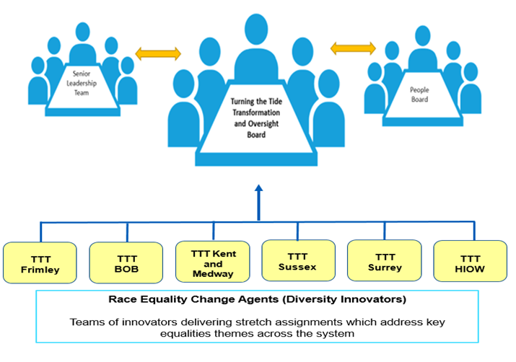
Sussex BAME Disparity Programme Governance
Membership
Co-Chairs Adam Doyle - Executive Co-Lead for the BAME Disparity Programme and Lola Banjoko - Executive Co-Lead for the BAME Disparity Programme
Tim Caroe - Chief Medical Officer on behalf of the Clinical Leadership Group and the Chief Medical Officers
Vivekanand Patil –- Co-Clinical Lead for the BAME Disparity Programme
Tanya Brown-Griffith –- SHCP Programme Director for BAME Disparity Programme
Mark Power - SHCP Interim Director of Strategic Workforce and OD
Glynn Dodd - SHCP Director of Programmes and current Director supporting Population
Claire Scott - Project Manager for BAME Population Workstream
Mathew Kuruvilla –- Project Manager for BAME Workforce Workstream
Jane Lodge - SHCP Associate Director of Public Involvement and Engagement Lead for BAME Disparity Programme
All SHCP BAME Network Chairs
BAME Community and Voluntary representatives from the places

Slide 6
Summary of health and social inequalities reports
1980 – The Black Report
1997 – Macpherson Report
2010 – Marmot report
2017 – Race Disparity Audit
2017 – Lammy Review
2017 -McGregor-Smith Review
2020 – Windrush Review
2020 – Marmot Review, 10 years on
2020 – Public Health England – Covid-19 Disparities

Slide 7
Inequalities across population and workforce
Health Inequalities
Mental Health Inequalities
Deprivation/poverty indicators
Lack of cultural competency at
place and system
Communication barriers
Access barriers to treatment
BAME people in more frontline roles
BAME people face racial discrimination
Less job security and underemployment
Challenging and sometimes hostile environment for migrant workers
Under representation in senior workforce and at Board Level

Slide 8
Disease Management / Mental Health Prevalence
Prevalence indicates the extent of a disease across a local population, with recent emphasis on improving identification rates to ensure patients have access to the right treatments and to identify commissioning hot spots – variability can be closely related to local demographics
Brighton & Hove
Has a lower % prevalence rate across most conditions within QOF when compared across Sussex
However higher than average mental health prevalence at 1.26% (Sussex avg 1.04%)
By PCN:
East & Central Brighton PCN1b has higher than average rates for mental health conditions :
Depression 14.6% (brighton avg 11.67%)
Mental Health 2.18% (brighton avg 1.26%)
PCN5 has one of the lowest Dementia diagnosis and prevalence rates in Sussex at 0.2% (sussex avg 1%)
East Sussex
Eastbourne & Hastings areas have higher % prevalence rates across most conditions within QOF when compared across Sussex
Depression shows a particularly high variance across Eastbourne 16.45% & Hastings 14.71% when compared across all other locations (sussex avg 12.7%)
By PCN:
ALPS group 18.53% and Hailsham 17.75% have the highest depressions rates in Sussex
West Sussex
Coastal West Sussex has higher % prevalence rates across most conditions within QOF when compared across Sussex
Crawley has high rates for Obesity 11.48% (sussex avg 8.73%) & Diabetes 8.0% (sussex avg 6.68%) but lower rates for most other conditions
By PCN:
High Depression rates seen within Lancing 17.98% and Shoreham 16.21%
Cissbury Integrated Care has a relatively high mental health prevalence at 1.51% (cws avg 0.99%)
Data Source: https://digital.nhs.uk/data-and-information/publications/statistical/quality-and-outcomes-framework-achievement-prevalence-and-exceptions-data - 19/20 QOF data (published Sep 2020)

Slide 9
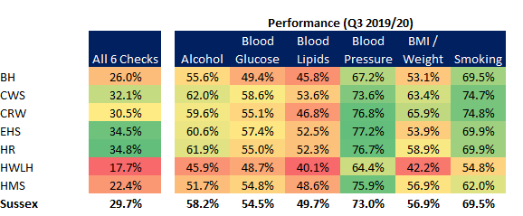
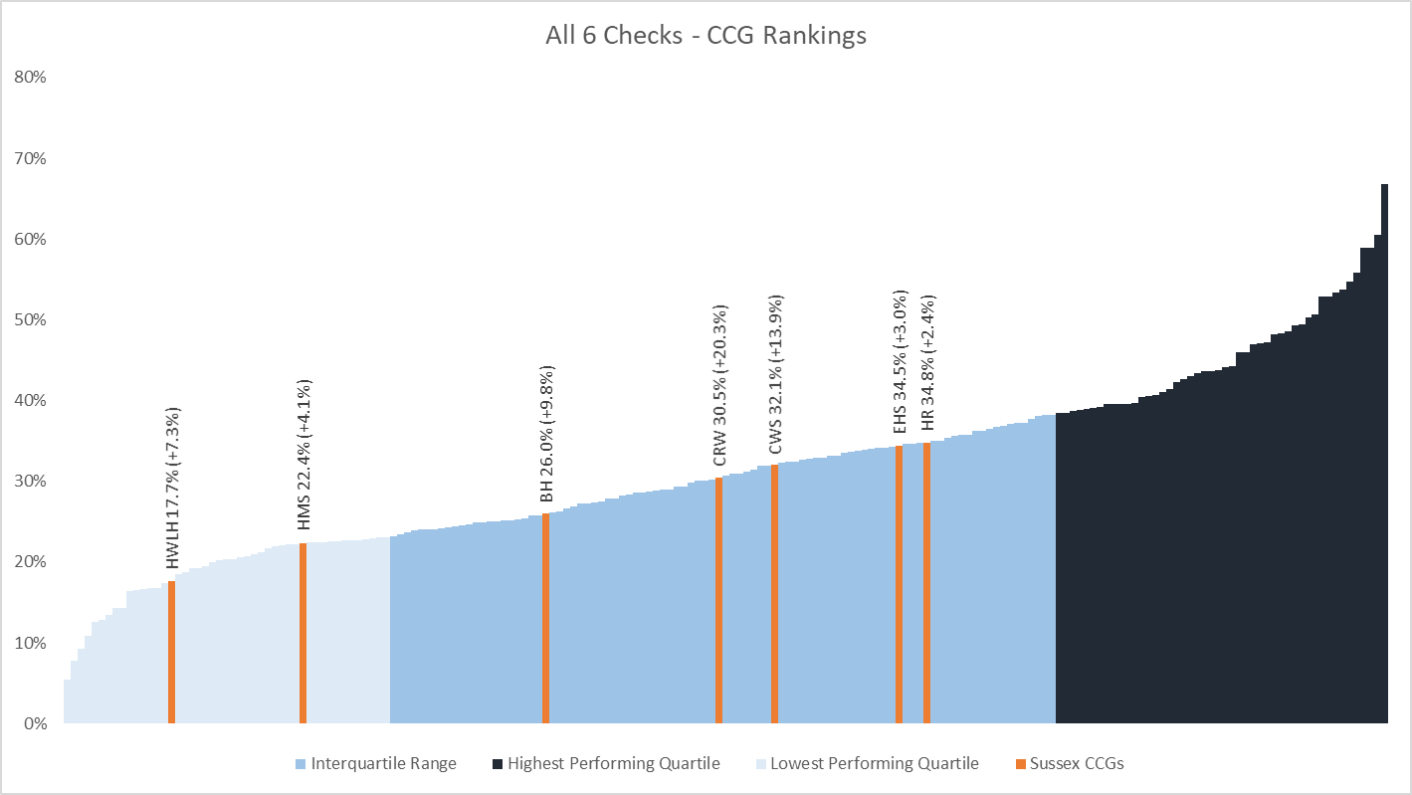
Physical Health Checks for patients with Severe Mental Illness (SMI)
The latest available data Q3 19/20. Q4 19/20 and Q1 20/21 were not submitted due to pressures from COVID-19 (with the exception of EHS and H&R)
EHS and H&R CCG had the highest coverage (34.5% EHS, 34.8% H&R)
HWLH and HMS had the lowest coverage (17.7% HWLH, HMS 22.4%)
All CCGs are particularly challenged in undertaking Blood lipid checks
HWLH have particularly low BMI checks (42.2%)
* We do not know this split by ethnicity but likely to be even lower coverage of health checks in persons from BAME Communities with severe mental illness and thus needs to be segmented from the data and addressed

Slide 10
Transformational change to Mental Health services
Recommendations:
The NHS should develop a proactive and tailored offer of MH support to people who have received hospital treatment for Covid-19, to people who are working in health and care services with people with Covid-19, and to people who have experienced a bereavement during this time– a large subset will be BAME communities.
As part of the NHS Long Term Plan commitments, core focuses will be on improvements mental health support to children and young people, community mental health services, 24/7 crisis services and liaison psychiatry
Each system to take actions to implement the Advancing Mental Health Equalities Strategy
Tailored mental health and wellbeing offer to across our workforce that is culturally relevant and delivered using inclusive communication
For the majority of people, the stress, anxiety and isolation everyone is experiencing now will be short-lived. It is also clear that for some groups of people the effects on mental health are more severe and will be longer lasting. And to a large extent, inequalities in mental health – which reflect broader economic and social inequalities – are being exacerbated in this crisis and likely to be perpetuated afterwards for groups such as the Black, Asian and Minority Ethnic Communities.
These communities already experience several known risk-factors which make people more likely to experience mental health difficulties which include unemployment, low income, racism and discrimination, traumatic experiences, violence or abuse. There are striking similarities between those groups who will be most affected by coronavirus and those where mental health problems are more prevalent.
Centre for Mental Health, COVID MH Forecasting, May 2020
Notes:
This extract came from https://www.centreformentalhealth.org.uk/sites/default/files/2020-05/CentreforMentalHealth_COVID_MH_Forecasting_May20.pdf

Slide 11
Better access to Mental Health services is critical
Many Sussex BAME community groups have identified a lack of communication in accessible and culturally relevant formats.
Data obtained from Sussex BAME communities after the height of the first COVID-19 wave highlighted the issue of lack of trust and confidence in mainstream statutory services. For example, In Brighton and Hove some local community and voluntary sector organisations reported that people were contacting their BAME wellbeing telephone line for COVID-19 support and wellbeing support as they were not confident that if they contacted mainstream services their concerns would be understood, listened to and the support adapted appropriately to be relevant for them.
We know that BAME communities have heightened anxiety and distress from their increased risk to COVID-19 but also from some of the divisive or racist comments surrounding this in local and national media. We also know that this further increased during the global Black Lives Matter social movement for many reliving trauma current and past that they or a family member experienced.
Recommendations:
Increasing access to interpreting services, more culturally relevant support, delivered by more representative workforce will increase BAME community access and uptake
Take the service information to where BAME communities meet – BAME grocery shops and restaurants, Barbers, Hairdressers etc.
“Mental health services have seen a huge spike in demand. But with most people unable to see a doctor or therapist in person, there has been a dramatic shift to new digital services.
There are more than 10,000 mental health apps available and more than 100 mental health start-ups are launched every year. Covid has sharply accelerated an existing trend.
In the UK requests for the NHS’s virtual mental health services have leapt 34 per cent in young people and 53 per cent in adults since the outbreak began.
Demand is being driven by the huge gap between the need for mental health care and its availability – and that can only be met by a revolution in the way it is delivered.”
Lord Darzi, Oct 2020
HSJ Magazine
Notes:
• Many black-African and Caribbean people, particularly men, do not have access to psychological treatment at an early stage of their mental health problem
• People from Black-African and Caribbean communities are 40% more likely than white-British people to come into contact with mental health services through the criminal justice system
• Gypsy, Roma and Traveller communities can have similar difficulties to those who are homeless
• BAME patients are less likely to rate their overall experience as 8 or above on a 10-point scale (44% vs 49% for white-British)
• Some people from BAME groups mistrust mental health services based on negative experiences
• Black adults are more likely than adults in other ethnic groups to have been detained under a section of the Mental Health Act

Slide 12
Sussex Community Research Findings around Covid-19
BAME people said they felt: anxiety, distrust, stress, conflict, confusion, fear and panic
Lack of access to GPs had a negative impact on mental health
BAME communities are disproportionately affected by poverty, health inequality and poor housing conditions
49% had negative experiences when accessing health care
communication and language barriers
cancellation of appointments often leading to poor health outcomes
perception of discriminatory treatment from health and care staff
Have needed help with finances. No recourse to public funds. Family abroad have to send them money. I cannot eat well. I have little support network.
Interviewee 127, a woman of Arab heritage
People didn’t understand the nuance and thought GP surgeries were closed completely, rather than just not seeing patients in person. Others didn’t understand the text messages from GP`s or the long answerphone messages.
SIS Linguists
I was constantly moved to cover higher risk areas. My white colleague would request the move and my line manager would approve. I am expected to be the one who travels and enters spaces with others who have may have been in situations where social distancing was not observed. I am stressed all the time.
A survey respondent identified as a British Black woman
We need more mental support for those BAME people who don’t have much family and friends. Support groups, chat groups, online network support group in different languages, mum’s forum. A platform where anyone can go to with any issues however big or small.
Interviewee 160, woman of Arab heritage

Slide 13
Our Next steps
Review the IAPT positive practice guides for BAME service users and older people provide guidance on how to provide care in a way that is more culturally sensitive and accessible
Patient and Carers Race Equality Framework (PCREF) developed and used to support mental health services to improve BAME experiences of care - Early examples of positive practice in improving BAME experience in mental health settings identified and shared wherever possible
Join or collaborate with relevant subgroups established to support PCREF and the Advancing Mental Health Equalities Taskforce established
Further BAME Community Engagement to co-develop our action plans to advancing Mental Health equalities – Access to Mental Health and Wellbeing Services Sussex Public Involvement Webinar being planned for January 2021
BAME health and mental health equalities promotion project e.g. using volunteer linguists and community ambassadors to improve access to health/mental health services
Working within the People Committee and within the priorities of the Sussex People plan to assess 2020 Workforce Race Equality Standards (WRES) data and support actions to enable a more diverse and representative workforce at all levels of the system, which is equipped with the skills and capabilities it needs to advance health and mental health equalities, is fundamental to achieving long-term change.
Turning the Tide Oversight Board being established to monitor improvements against reducing racial and health inequalities
BAME System Dashboard
BAME Population Needs Assessment

