Slide 1
Healthwatch (Sussex)
Dr George Findlay | Chief Executive Officer
Monday 15 January 2024

Slide 2

Contents
Performance
Challenges
CQC
QSIP
Looking ahead
Thank you

Slide 3
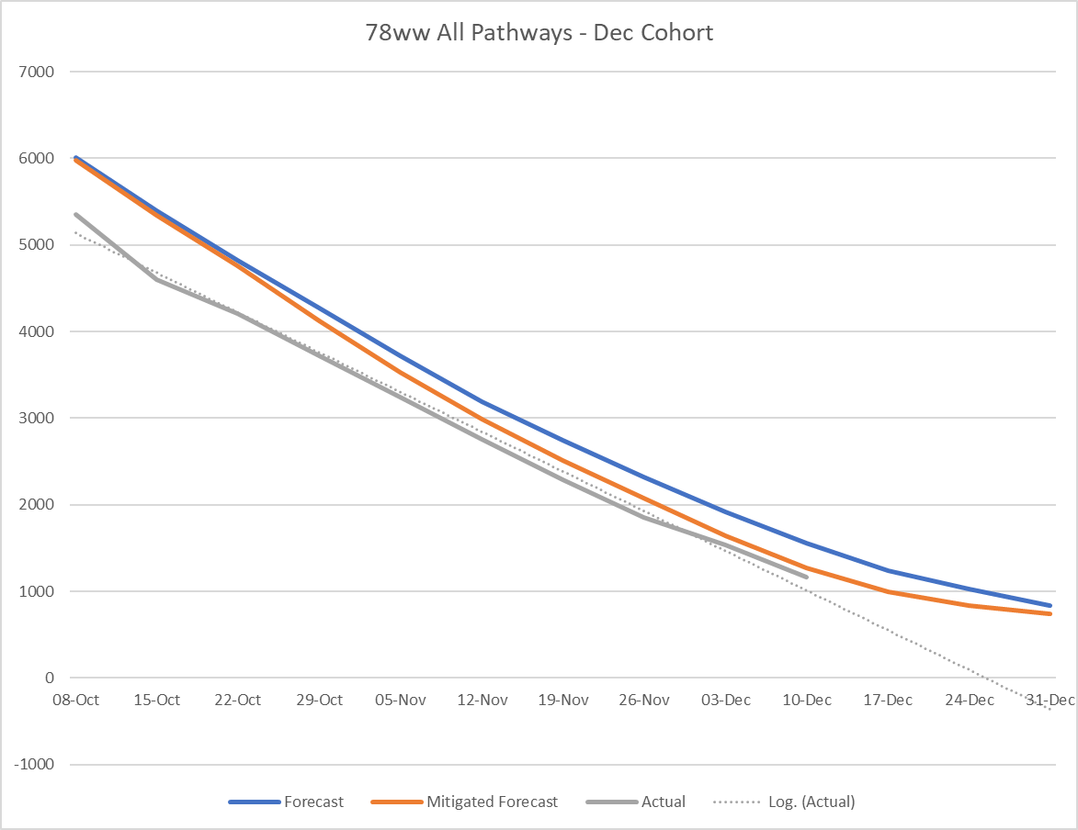
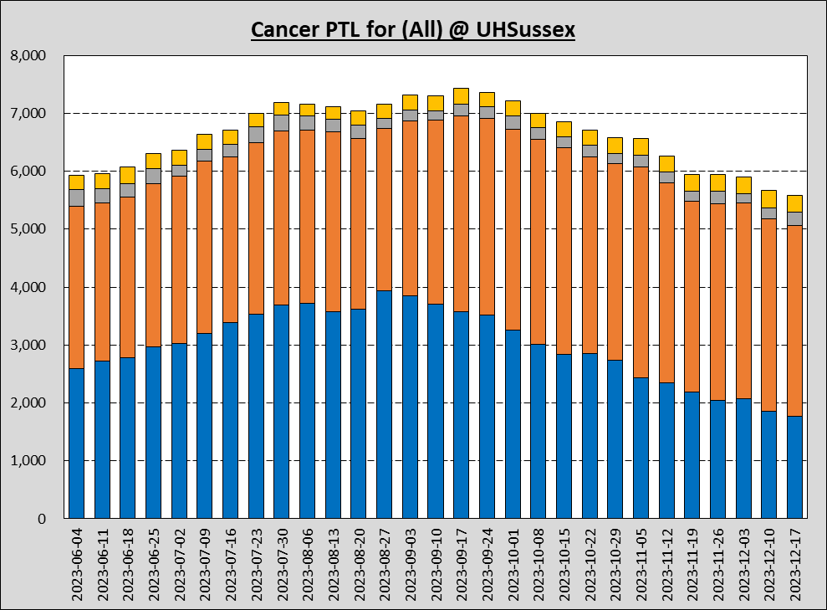
Performance
Total 78-week waits - Oct-Dec 2023
Waiting list - before recent strike action and annual Christmas disruption, we had reduced total waiting list by 11,000 patients in 11 weeks.
Cancer - total waiting list continues to reduce - as of 17 December = c5,700 - which is lower than June 2023 and nearer long-term average = c5,500 - but recent strikes have impacted improving trend.
A&E - Average 63% against 4-hour target in December. Increasing demand is exacerbated by huge numbers of medically ready for discharge patients remaining in hospital while waiting for packages of care to go home.
Cancer waiting list - June-Dec 2023

Slide 4
Challenges
Staffing – recruitment and retention | health and wellbeing | morale and fatigue
Resources – no more money this year, e.g. winter funding, from Treasury
Efficiency requirements – challenging demand to continue to find savings
Productivity – difficulty returning performance to pre-pandemic levels
Winter pressures – seasonal pressures as acute as ever
Scrutiny – intense levels of scrutiny from regulators, public, media and Operation Bramber
Industrial action – strikes continue to exacerbate all other issues

Slide 5
Care Quality Commission
August 2023 – CQC inspected each of our main hospitals, with a focus on Emergency Care, Medicine and Surgery
Inspection report not published yet by CQC – but expected in coming weeks
Staff, stakeholders, patients and public will be briefed on details
All ‘must do’ actions and regulatory requirements will be prioritised and addressed through our new Quality and Safety Improvement Programme (QSIP)

Slide 6
QSIP
Improving quality governance, risk management and assurance
Improving access to surgery
Improving safety culture
Well-led
Engagement
Enabling workstreams
Communications
Key deliverables in each workstream:
Improving quality governance, risk management and assurance | Well-led | Improving access to surgery | Improving safety culture
The standards that need to be delivered The policies that support this The measurement of how we are doing How we need to improve The provision of assurance | Overseeing the delivery of well-led improvements, based on CQC requirements, best-practice, staff and stakeholder feedback | Focus supporting division with onward improvements, many initiated through the Improving General Surgery corporate project Right-sizing theatre capacity across the Trust Ensure the provision of surgery is maximised across the Trust | Improve safety culture, ensuring relevant training is embedded Delivery of a framework tool to help effectively measure safety culture Enhance the effectiveness of reporting and feedback, and embed an open, learning culture
Notes:
QSIP is a new quality and safety improvement programme that will give us - and our stakeholders - confidence in the fundamental standards of the care we provide.
Some of its areas of focus are about bringing together our predecessor organisations and setting our new trust up for success (eg governance and culture).
Some are long-standing issues that we still need to resolve (eg surgery).
Others are things identified by the CQC and staff feedback (eg leadership).
QSIP gives us a framework for making these improvements - and permission to prioritise them in your teams.
QSIP is an enabler to our Patient First programme – it will give us the strong foundations our new organisation needs to progress towards our True North goals.
IMPROVING QUALITY GOVERANCE
​We can’t provide safe, high-quality care if we don’t have consistent standards, policies and processes across our hospitals, or agreed ways of reporting compliance and responding to identified risks.
Bringing together two large organisations and seven hospitals has made this a difficult task.
The quality governance, risk management and assurance workstream will accelerate the process.
It is creating a trust-wide quality governance framework, setting priority safety standards and metrics, and harmonising policies and procedures to support these.
Having these in place will improve patient safety and clinical outcomes, reduce mortality and risk, and give colleagues more confidence in their roles and responsibilities.
2. WELL-LED
The CQC’s most recent ‘well-led’ inspection rated us as ‘inadequate’ on this measure.
The well-led workstream aims to make improvements that will enable a higher rating when next assessed.
Some of these are required by the CQC, others have been identified from our own staff feedback.
Areas of focus include leader visibility and support for colleagues, communication and engagement, staff willingness to raise concerns, and more inclusive leadership behaviour.
Improvements made will support good leadership at all levels of the organisation, improve staff experience and contribute to the delivery of high-quality, sustainable care
3. IMPROVING ACCESS TO SURGERY
We’ve been working for some time to improve the leadership, culture and practice of general surgery at RSCH and PRH.
Many of the department’s issues stem from a mismatch between capacity and need that cannot be resolved by action at RSCH and PRH alone.
This workstream is looking to better utilise theatre and workforce capacity across the trust to improve access to surgery and unlock quality and sustainability benefits of more integrated working.
Doing this will improve outcomes, reduce emergency surgery delays, cut waiting times and improve staff experience
4. IMPROVING SAFETY CULTURE
We are currently rated as requiring improvement under the CQC’s ‘safe’ domain, while some staff report that safety concerns are not listened to or acted upon.
We have been doing a lot of work encouraging colleagues to speak up on safety issues.
This workstream widens that into a broader effort to improve incident reporting and give our people confidence that action will be taken, as well as embed safety considerations into all activity.
As well as increasing the number of incidents reported, we will also be widening safety training and promoting the civil working environments known to reduce the errors and stress that can compromise safe care.
Achieving these goals will improve patient safety and staff experience.

Slide 7
Looking ahead
New Community Discharge Centre in Shoreham – official opening 26 January
NHS Staff Survey results – published February / March
Our Patient First STAR Awards – launches February, can you help promote?
Culture, values and behaviour – new staff engagement programme
New Sussex Cancer Centre at RSCH – revised planning application March
RSCH A&E – new Surgical Assessment Unit and Same Day Emergency Care unit opening as part of our £48m Acute Floor Reconfiguration programme

Slide 8
Thank you
Thank you to Healthwatch for collaborating with us, as well as being our critical friend, helping us improve patient experience
Healthwatch “Enter & Views” – feedback helping to inform our improvement plans and recently including new Louisa Martindale Building – thank you
Our new Welcome Standards and Training Programme has been informed by your Healthwatch Communications Charter – thank you
Collaboration on key initiatives and corporate projects, including excellent Healthwatch contribution to our Length of Stay programme and RSCH Acute Floor Reconfiguration

Slide 9
Any questions?

