Slide 1



Healthwatch Brighton and Hove
Annual Report 2013-2022
Celebrating 10 years

Slide 2

Contents
About us
Messages from our Chair 3
Messages from our CEOs 5
Our 10 years on a page 6
A potted history of Healthwatch 7
What our partners have said about us 8
Our impact over the years 10
Thank yous 20

Slide 3



About us
Your health and social care champion
  Healthwatch Brighton and Hove is your local health and social care champion. From Whitehawk to Portslade and everywhere in between, we make sure NHS leaders and other decision makers hear your voice and use your feedback to improve care. We can also help you to find reliable and trustworthy information and advice.
Our vision
  A world where we can all get the health and care we need.
Our mission
  To make sure people’s experiences help make health and care better.
Our values
  Listening to people and making sure their voices are heard.
  Including everyone in the conversation – especially those who don’t always have their voice heard.
  Analysing different people’s experiences to learn how to improve care.
  Acting on feedback and driving change.
  Partnering with care providers, Government, and the voluntary sector – serving as the public’s independent advocate.

Slide 4
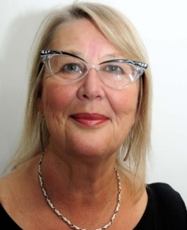
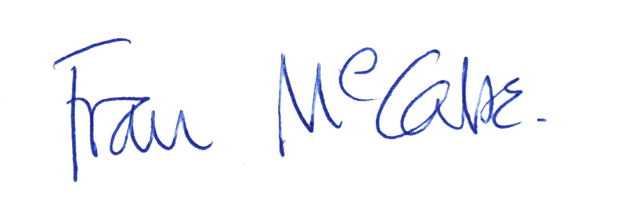
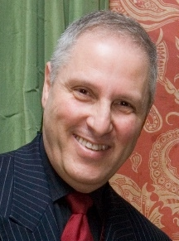


Messages from our Chairs
Fran McCabe, Chair 2013-2022
One of the reasons I wanted to become Chair was I could see the strength of having a network of Healthwatches and a national body to harness intelligence and evidence. In the first year or so, we created a strong board, had staff settling into their roles, and brought in a strong CEO, David Liley. Healthwatch has always punched above its weight with small group of staff and a loyal cadre of volunteers who are its eyes and ears. Making relationships with health and care personnel has been a key activity to gain trust and credibility. Healthwatch has developed a reputation for strong evidenced reports based on the experience of people who use health and care services as patients, service users and carers.
Healthwatch is the 'go to’ organisation both nationally and locally to get patient and user views about health and social care: and the vision that I and others had - that there was strength in collaboration and validating individual experiences at a national level to influence and change policy and practice - is now central to the Healthwatch endeavour. I am very proud of what we have become.
Geoffrey Bowden, Chair 2022 onwards
We

Slide 5
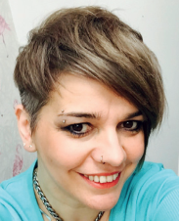
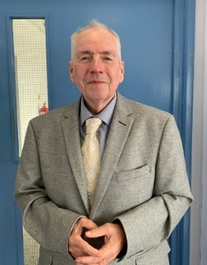

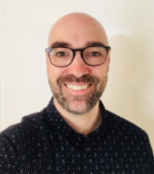
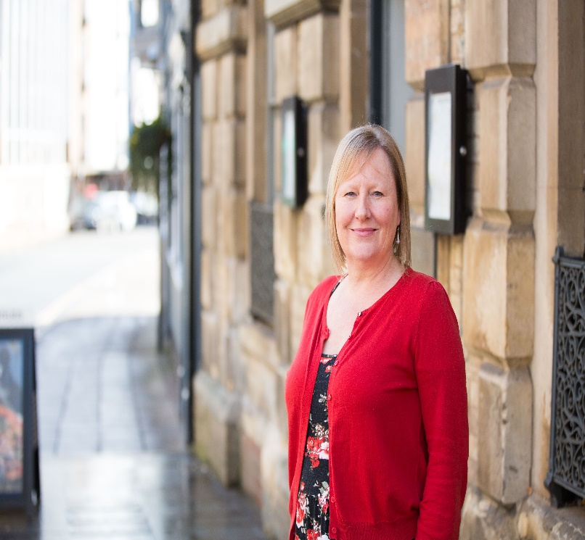
Messages from our
Chief Executives
    Nicky Cambridge, 2013-2015
    David Liley, 2016-2022
    When local Healthwatch was first established it did not know what it was and we had to build on previous attempts to establish a unified voice for the patient and public opinion. I was appointed in April 2016 and from then on, we have built a reputation for powerful evidence-based reporting, bringing the patient voice to the centre of topical issues, and being a fearless but balanced critical friend to health and social care. Our various reports over the years have strengthened our role as the authoritative voice for independent and accurate information and assurance. Our reputation has increased and strengthened, reflected by our award-winning projects. It has been a privilege to have led the organisation for over six years and worked alongside so many talented and dedicated staff members, Board and volunteers. I look forward to watching how the organisation continues to grow and adapt.
    Alan Boyd – 2023 onwards
    It is impossible to describe everything that Healthwatch Brighton and hove has done and achieved over the last 10 years but in this report, we highlight a sample of the projects, reports, events, advice and support – and more that we have produced and been involved with. At the heart of everything we have done have been our city's residents.
    None of this could have been possible without the hard work of all the people who have worked for us, to our various Board members and our outstanding volunteers who have given so much of their time and ideas to support us.
    We could also not have succeeded without the support of our various partners working across the voluntary and community sector, NHS services, the Council, our other Healthwatch colleagues, and those who commission and deliver.
    To everyone who has been involved, from the bottom of my heart – THANK YOU.

Slide 6
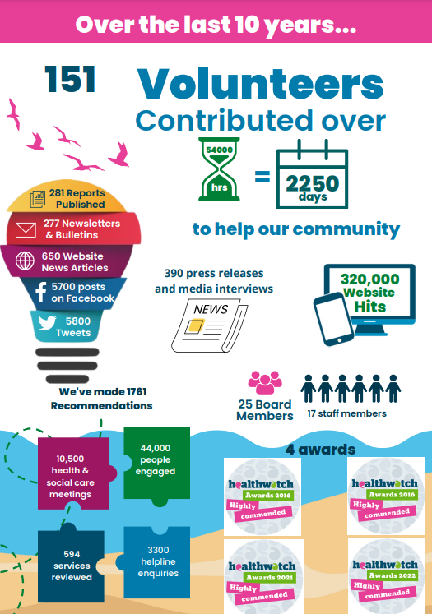

Slide 7
A potted history of key dates
Year | What happened
2012 | Healthwatch is set up under the Health and Social Care Act 2012.
2013 | Healthwatch Brighton and Hove is formally inaugurated in April 2013. We are hosted by Community Works and our first staff team join us. We also publish our first report.
2014 | The Mayor of Brighton & Hove formally launches Healthwatch Brighton and Hove on 5th March. We are formally registered as a Community Interest Company on 14th October. Our first volunteers join us this year.
2014/15 | Our Board of Directors is formed. We begin our Enter and View Visits to local health and social care services, launch our newsletter and start our public helpline. And more than 1000 people sign up to receive our newsletter.
2015 | We become an independent Community Interest Company in April.
2016 | We win two Highly Commended awards from Healthwatch England for our Partnership working.
2017 | We set up our monthly volunteer led visits to our local hospitals.
2017 | We establish our Young Healthwatch.
2017/18 | Young Healthwatch publishes their first report looking at A&E and experiences of mental health services.
2019 | We successfully nominate one of our longest serving volunteers, Sue Seymour, for a Rotary Club of Brighton Community Service Award. We launch our Homecare check service, still operating today.
2020 | We start to issue our COVID bulletins and start our award-winning Hospital Discharge project. More than 70 volunteers support our work throughout the pandemic
2021 | We win our third Highly Commended award from Healthwatch England for our Hospital Discharge project. Our End of Life project is also shortlisted. Our volunteers speak to over 1700 recently discharged from hospital.
2022 | We win our fourth Highly Commended award for our work in helping patients to overturn a decision to reduce opening hours at a local GP practice. We are awarded a 3 year direct contract renewal to continue running Healthwatch for the city.

Slide 8
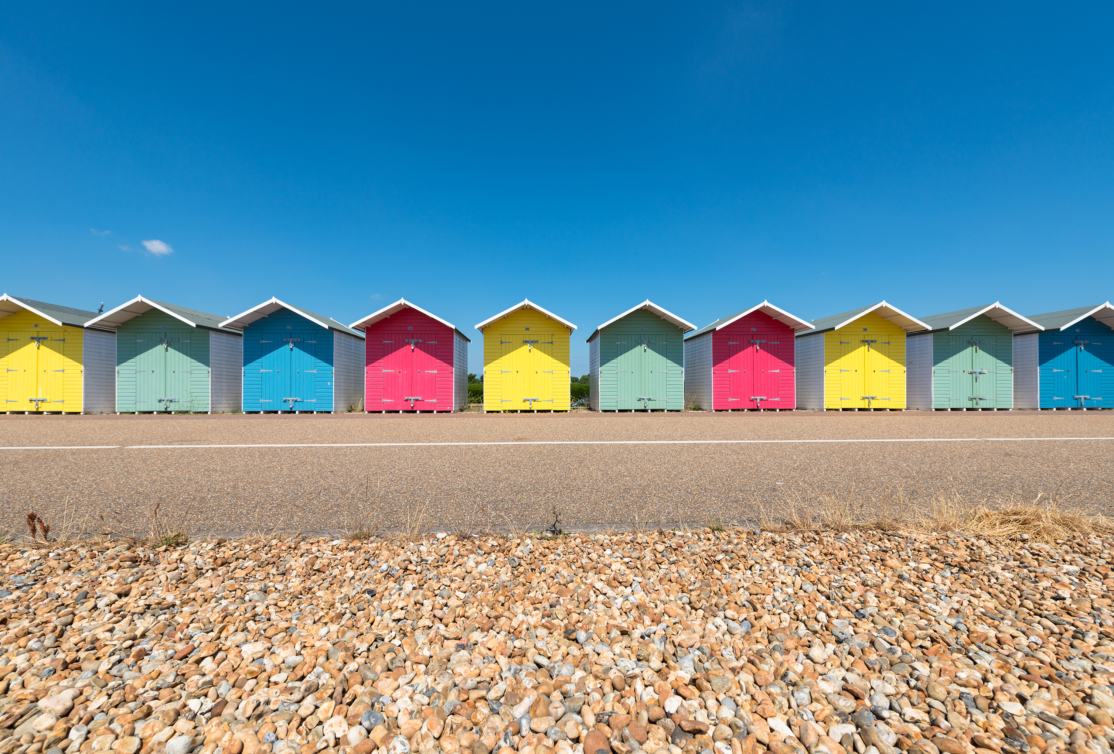
What our partners have said about us over the years
“It's vital we pay attention to the voice of our local communities and the people who use health and care services. Healthwatch plays a vital role in bringing this voice to the fore. Thank you for being a champion, a critical friend and an influential agent for change in shaping the way health and care services are provided for residents of this city.”
Dr Jane Padmore, Chief Executive Officer
Sussex Partnership NHS Foundation Trust
“This report continues to evidence the importance of Healthwatch in Brighton and Hove. Their reports are invariably balanced in content to both hold services to account and try to secure further service improvement”
Rob Persey, Executive Director of Health & Adult Social Care, B&H City Council
““Healthwatch has played an important role in being a critical friend to the CCG and has helped us embed the voice of patients in the work we do.”
Adam Doyle, Chief Accountable Officer of NHS Brighton and Hove CCG
““Social Care, Safeguarding and Public Health have all benefitted from Healthwatch evidence-based reports in the last year. These reports are an important source of independent evidence gathered from patients and service users and can be used to support continuous service improvement.”
Rob Persey, Executive Director for Health and Social Care, Brighton and Hove City Council
“Heathwatch brought an excellent focus for patient understanding of their discharge with their questionnaires.” CCG evaluation report
"Healthwatch’s input is invaluable and promotes engagement with clinical colleagues, reinforcing that things are always considered and viewed from a patient’s perspective. There have been a range of projects that have had a significant impact on our environment, all of which Healthwatch has been instrumental in helping to deliver.“
Former Deputy Chief Nurse,, Brighton & Sussex University Hospitals Trust
“The CCG will like to extend its thanks to Healthwatch for its support to the system in responding to COVID-19. We particularly appreciate the regular feedback, which allowed us to respond quickly to any issues and strengthen our work to help ensure the public were getting the care they needed, and the regular bulletins which provided a rich and crucial source of information with inspiring patient stories.”
Lola Banjoko Executive Managing Director

Slide 9
“We were delighted to be able to work in partnership with Healthwatch this year to highlight the challenges which LGBTQ+ communities face. Alan and the team were passionate and committed to improving the experience of LGBTQ+ across Health and Social care.”
Jane Woodhull (she/her/hers), Health and Inclusion Coordinator
LGBT+ Switchboard
“Healthwatch is an active partner at the city’s Health and Wellbeing Board. The voice of service users across our health and care services are crucial to develop and build stronger, more resilient services for the future.”
Councillor for Moulsecoomb and Bevendean, former Chair, Brighton & Hove Health and Wellbeing Board
““Brighton and Hove CCG welcomed the findings from the Healthwatch GP report. It highlighted some important opportunities for service improvement and I am confident this will provide an impetus to progress and improvement” Dr David Supple Clinical Chair, Brighton & Hove CCG
“We are very pleased to see our residents' views are being listened to in such a meaningful way and thank Healthwatch for their work in highlighting how the reduced hours in New Larchwood Surgery in Coldean is having a detrimental impact on more than 2,000 registered patients that use the service, and especially so for some of the more vulnerable groups.”
Zoe John & Martin Osborne
B&H City Councillors
“East Sussex Local Dental Committee had the pleasure of working with Healthwatch over the past few years. We are looking forward to continuing our joint working relationship with you for the benefit of your local population and the dental workforce.”
Nish, Chair, East Sussex Local Dental Committee
“Healthwatch are valued partners, delivering crucial insights into the experiences of individuals using social care services across the city. Healthwatch has supported a number of projects on behalf of Brighton & Hove Adult Social Care Commissioners“
Alex Saunders, Commissioning & Contracts Manager
Brighton & Hove City Council
“Our local Healthwatch is an effective voice for local health and care service users, shining the light on where we could do better but always offering constructive suggestions for improvement.”
Cllr Clare Moonan

Slide 10

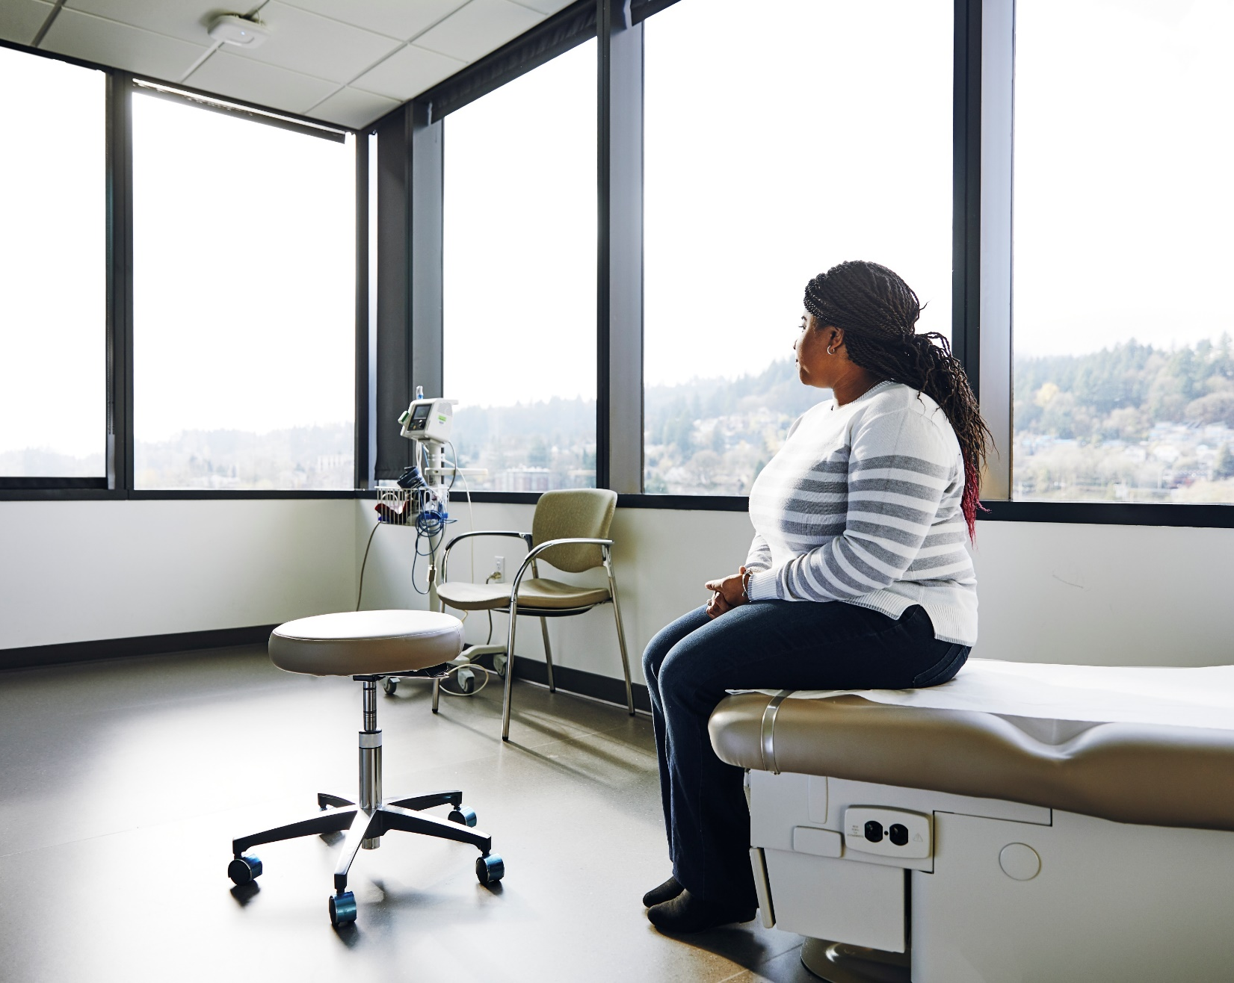
Our impact over the last decade
Your stories and feedback have the ability to deliver real change to local health and social care services that can benefit everyone in the city . Over the last 10 years more than 44,000 people have shared their stories, views and opinions with us

Slide 11


Helping the public
Over the last 10 years, our dedicated Healthwatch Helpline has answered over 3000 of your queries and questions.
We have shared your feedback with NHS services and Commissioners, helping thousands of others as a result.
“I’ve met a lovely lady at the local community festival who not only listened to my horrible experience, but also provided me lots of useful information. She encouraged me to not let the issue go, but to speak to her colleague [at the Healthwatch Helpline] who eventually helped me to resolve all my issues.”
“You have been helpful, understanding and patient … thank you for your help today – much appreciated to be listened to and treated with respect.”
Your top queries to our helpline us over the last 10 years have been about COVID vaccinations, requests for information about NHS dentists, complaints about NHS and social care services and concerns or requests for advice concerning GPs and GP practices
“I just want to express my grateful thanks for the information on local services document you have prepared and distributed. This is very helpful and answers various questions I had. Much appreciated.”
“A wonderful report which I have been raising at a range of meetings in the city to make sure everyone has seen it. Brilliantly written and accessible.”
“My Mother passed away at the RSCH recently and I thought it best to let you know. I know that she spoke very highly of your team and the people that called her. I personally would like to offer my heartfelt thanks to all involved.”

Slide 12

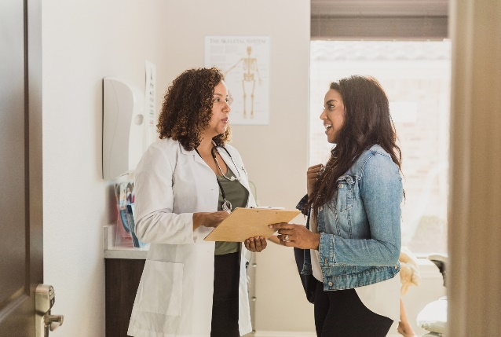
Our GP focussed work
Over the last 10 years, we have been proactive in providing support to patients, helping them to navigate many changes affecting primary care.
In 2022, we supported patients at New Larchwood Surgery to overturn a decision to reduce opening hours at a local GP surgery.
“I would like to thank you from the bottom of my heart for the sterling work you put in on our behalf. Now we have the final findings from you and consequently, the resulting actions from the CCG and GPs at the surgery.”
Anna de Wit, Chair, Coldean Residents’ Association
In 2015/16, we contributed to the national learning on how best to engage and support patients when their surgery closes.
In 2017/18, we worked with the General Medical Council (GMC) providing feedback on the standard of services provided by individual doctors. We arranged focus groups in Brighton and Hove to help the GMC improve the ‘revalidation of Doctors’..
Our GP reviews
We have conducted several reviews of GP services over the years to understand what people think about services. Over 4,000 people have shared their opinions with us.
This has shown high levels of satisfaction.
Revealed low awareness of some screening services which led us to support our Clinical Commissioning Group’s (CCG) involvement in the Local Cancer Services Scheme to help shape the bowel screening service.
We’ve highlighted concerns around the falling number of GPs in the City.
We’ve flagged concerns around timely access to see a GP appointment.
We’ve shown that people are delaying making a GP appointment and highlighted how this has led some people to seek help from other parts of the NHS sometimes creating more pressure on that part of the system.
We’ve gathered your views on using alternatives to face-to-face appointments.
We’ve reviewed practice websites and Out Of Hour messaging during COVID to ensure patients were getting the support and advice they needed.
In 2015/15, Care Quality Commission (CQC) inspections of some GP surgeries in Brighton and Hove noted a high number of safeguarding problems. We provided an analysis of the issue and shared it with the CQC, the city’s Health Overview and Scrutiny Committee and the Brighton and Hove Safeguarding Panel. We escalated the issue to Healthwatch England. The inadequacy of safeguarding processes in general practice has since been highlighted in national reports.

Slide 13

COVID-19 – our response
During the pandemic, our staff team were active and remained working throughout. We strengthened our role as the authoritative voice for independent and accurate information and assurance. Our reputation, already secure, was increased and strengthened.
Reports - we were one of the first community organisations to publish consolidated information and established ourselves early on as a ‘go-to’ organisation for accurate and up-to-date information, receiving praise for our role.
Bulletins and Advice - we published over 100 bulletins on COVID-19 and vaccinations, keeping people updated and aware of changes. We attracted praise from Councillors and local MPs, the public, press, and senior city-leaders for the quality and breadth of our updates.
Vaccine Helpline
Between April 2021 and March 2022, 12 Healthwatch volunteers:
answered an amazing 1,460 calls via the city’s vaccine helpline.
contributing 536 hours!
“It's been great to help out here, I've really enjoyed it."
— Healthwatch volunteer
“The majority of callers I have spoken to are extremely grateful for the help they are getting from the team."
— Healthwatch Volunteer
"Healthwatch volunteers have been absolutely amazing.”
“I wish to take this opportunity to thank all the volunteers for their hard work and commitment.” — Vaccine Enquiry Helpline Line manger
Supporting carers
As a result of the concerns we had heard, we held a series of events in 2020 and 2021 on behalf of informal carers of care home residents. We provided a space for them to ask questions and gain answers from health and social care representatives. These events ensured that the voice of informal carers and care home residents were heard. They also raised important issues which influenced decisions made by system leaders.
  “Care Homes really matter, and families and friends of residents have a very important role to play in the shared care of residents.”
  Dame Philippa Russell
  On how the 2021 webinars
  highlighted the important relationship between the care home and their families.
Cancer patients - responding to concerns about a lack of information about cancer services and care homes during COVID19 lockdown by delivering a series of webinars attended by local experts who answered their questions.

Slide 14

Our Hospital work
Over the years, we have carried out numerous visits to our local hospitals, surveyed patients, raised your concerns and feedback and built a strong partnership with Trust staff. We’ve also provided feedback to the Care Quality Commission.
Hospital Discharge projects
In 2018/19, we visited 80 patients in hospital aged 65+ years and then re-visited them at home, following their discharge from hospital. In direct response to ten recommendations we made from this work, the CCG and Hospital Trust jointly wrote an action plan to improve hospital discharge.
As part of our COVID response, this project - jointly funded by the local council and NHS Clinical Commissioning Group - started in April 2020. Our volunteers have called people recently discharged from hospital to check on their wellbeing.
6530 people have been referred to the project
2404 people were supported by our volunteers
23% were referred for some additional community support
23% of people had some issue or concern related to their hospital discharge
In 2015/16, proposals made by Healthwatch Brighton and Hove to improve the Urgent Care Centre in the A&E Department at the Royal Sussex County Hospital were incorporated into their modernization plans (2015/16).
In the same year, our A&E reports resulted in 28 recommendations being acted upon by the Royal Sussex County Hospital (2015/16).
In 20i6/17, an investment of £2 million in a project to improve the Eye Hospital at the RSCH was partly prompted by a report from Healthwatch Brighton and Hove (2016/17).
Hospital Enter & Views
Since 2017, using our Enter and View powers, our volunteers have conducted regular visits to our local hospitals looking at the physical environment and how this could be improved. They have made 27 visits to over 50 wards and departments making over 450 recommendations.
The Trust has acted on many of our recommendations and suggestions and reported back to us through regular meetings, where we receive feedback and action plans following our visits describing what the Trust proposes to do about the issues and concerns raised.
We estimate that thousands of patients will have benefited from the improvements identified by our volunteers over the years.

Slide 15
Our work on dentistry
Requests for help and advice around NHS dentistry has always been one of the main reason why patients have contacted us
Requests for help to find an ‘NHS dentist’ are how the second main reason people contact our public helpline. Between 2020 to 2021 we saw a 271% increase in dental queries between 2020 to 2021.
As a direct result of your dental enquiries, we have worked with Healthwatch teams across Sussex, dental practices and the Local Dental Committees (who represent dentists in the South East) to create a guide to your rights and how to access the treatment you need.
We have shared them with Healthwatch England to deliver national campaigns to improve access.
We have also worked with local MPs to raise your concerns in Parliament and fed into national Parliamentary inquiries.
“I have worked closely with Healthwatch over the past year, particularly on dental issues. Their expertise, experience and professionalism have been invaluable to me in my work scrutinising Ministers. I look forward to continuing to cooperate in the coming year and doing what I can to ensure their voice as an independent champion for those needing health and social care services in Brighton and Hove is properly heard. Thank you to David, Alan and all the brilliant Healthwatch team!”
Caroline Lucas, MP for Brighton Pavilion
Supporting good oral care in care home
In early 2019, in response to UK-wide concerns about oral care in care homes, we spoke to 111 care home residents and 75 care staff across 20 homes in the city. Healthwatch was invited to share materials at the Care Home Forum, presenting to the Home Care Forum and Local Dental Committee. We were also invited to present at the Healthwatch Annual Conference
We have also reviewed dental websites and out-of-hours telephone messages to ensure they were providing patients with up-to-date and relevant information.

Slide 16

On work on Mental Health
In 2015/16, in partnership with Sussex Partnership NHS Foundation Trust (SPFT) and Speak Your Mind Young People’s Advocacy Project, we held two workshops for young people aged 16-25 with mental health needs. Insights from the sessions were shared with national partners, which led to the improvement of resources and the development of an interactive website.
In 2016, Healthwatch worked with MindOut, a local mental health charity for LGBTQ people, to develop a successful proposal for a specialist Trans advocate. We understood this to be the first post of its kind in the country and we are delighted that it was Highly Commended at the 2016 Healthwatch England awards.
Mental Health and accommodation
In 2022, Healthwatch explored service user experiences of mental health services and accommodation providing mental health support in our city. We gathered the experiences of 137 service users and 96 mental health professionals. We made recommendations to the Brighton & Hove City Council (BHCC) and the Brighton & Hove Clinical Commissioning Group (CCG) and our findings were incorporated into the City’s Mental Health Joint Strategic Needs Assessment.
We have shared advice to the LGBTQ+ community on how to access mental health support.
Sector Connector
In 2021, working with Healthwatch colleagues, we launched Sector connector - a way for non-NHS organisations (the Sector) to engage and influence the Sussex Health and Care Partnership Mental Health Programme.
The project was been developed by voluntary and community sector organisations across Sussex.
We shared advice on staying active indoors & looking after your mental health during Covid-19
We promoted the launch of the Sussex Mental Healthline.

Slide 17
Some of our other activities
Sexual Health
In 2016/2017, Healthwatch raised concerns about privacy and the physical environment at a sexual health clinic in the city. A team of managers and nurses were there the next morning to start an improvement programme.
Personal Benefits
In 2017/18, our report on the experiences of people accessing Personal Independence Payments and Disability Living Allowance assessments was shared with the Parliamentary Select Committee. We also sent a joint letter with the Chair of the Safeguarding Adults Board, and to the Secretary of State at the Department of Work and Pensions (DWP). We used our influence to set up, for the first time, meetings between DWP officials, representatives from PIP assessment providers and local charities and groups advocating on behalf of vulnerable adults. This created direct routes of contact, provided ‘top tips’ for caseworkers, and better explained some application processes.
Pharmacies
In 2018/19, when asked about online pharmacy services, 60 out of 91 people told us they had received marketing about them by post or leaflet. Many people found the marketing information confusing including the use of the NHS logo in what was private business advertising. When we passed on these concerns nationally, the ensuing social media discussions received 25,000 hits, more than any issue we’ve raised.
Homecare services
Our Homecare project has evolved over the years to meet the needs of our city. But it was originally started to learn more about the care people received in their own homes.
Our volunteers have interviewed more than 193 residents about their home care, from 11 different providers. As a result of these interviews, we have raised 26 reviews/concerns reported to the Council’s Access Point, of which 6 were for safeguarding concerns.
We have also shared many examples of excellent care.

Slide 18

End Of Life care
In 2022/21, we conducted a review of how good end of life care was at our local hospital (2021)
Our work was nominated for a Healthwatch England award for the contribution our volunteers had made. Our earlier report (September 2020), found that End of life care was not a
dignified and well-arranged experience for many.
Our recommendations were accepted in full by the NHS
and since then, processes have taken place to
embed our report findings into strategy and policy.
Our city's Health and Wellbeing Board Committee (HWB) received the report and proposed that it form part of their 'Dying Well' programme. They requested that the report was brought back to the Committee for monitoring in March 2021
Non-Emergency
Patient Transport Services
Working with colleagues across Healthwatch teams in Sussex, we have delivered 4 patient reviews of the service in 2016, 2017 and 2020.
We have fed your views into a national NHS review of the service.
We have presented our concerns – based on your views – to our city’s Health and Scrutiny Overview Committee, flagging major concerns over the failure of the service in 2016 and demanding immediate improvements.
We are working with those responsible for commissioning a new service from 2025 and they have taken on board your views from our last patient review of the service in 2020 and fed these into the service specification – YOUR views lie at the HEART of service redesign.
Reviewing NHS Services
Equipment and Adaptations Service
We have conducted two reviews of this service (2016 and 2022) which is for people who need extra help to live at home can access equipment such as grab rails, stair rails or ramps, and appropriate aftercare. Our reports have included the views from over 900 service-users and professionals. Our recommendations have fed into the future service specification including improving the recycling of equipment and being able to order and review deliveries and installations (including reporting faults) online.

Slide 19

Young Healthwatch
In 2017, we commissioned YMCA DownsLink Group to find out what young people think is going well, and what they think needs improving.
Over the years we have used these findings and communicated them to the people who run services, so they know how to best support young people and help make their services as accessible as possible.
Young Healthwatch held listening labs’ seeking out the views of hundreds of young people about the health and care issues that matter to them
They explored young people’s views on mental health services during the COVID-19 pandemic.
They gathered the views of young people from ethnic backgrounds on local sexual health services and barriers to access. Their report was shared with the Lead and Deputy Commissioner for these services.
They asked young people about their experiences of A&E.
They spoke to young people across local schools asking for their suggestions to improve the school environment, create better relationships with teachers, and suggested that information on improving emotional and mental health be embedded in the curriculum and learning. The Young Healthwatch Report fed into a Sussex-wide NHS review of Children and Young People’s access to psychological therapies.
In 2015, Young Healthwatch visited GP surgeries for observational visits and interviewed young people. They have recommended changes including: better information about emotional support and access to psychological services; respect for the privacy for young people when they want to discuss confidential personal issues. The YMCA ‘Right Here’ project working with one GP surgery to make it a beacon practice for young people.
In 2020/21, Young Healthwatch produced videos and apps for children and young people who have greatly struggled during the pandemic.

Slide 20
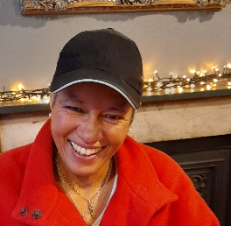
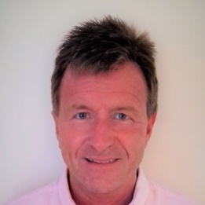
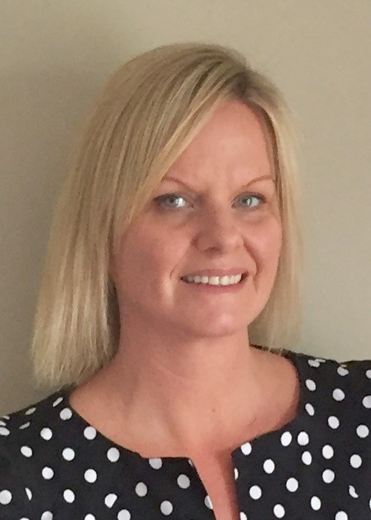
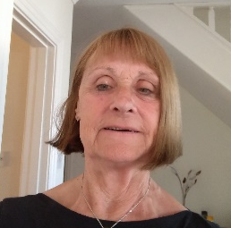
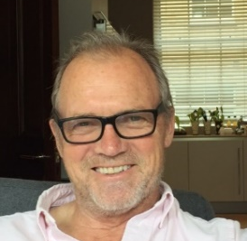
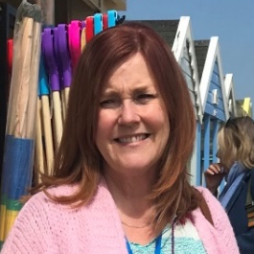
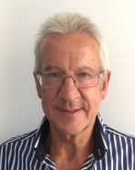
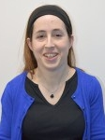
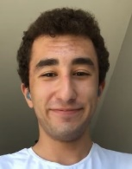
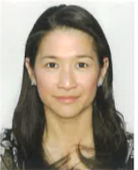

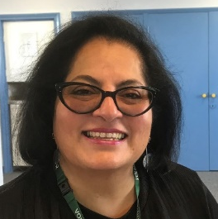
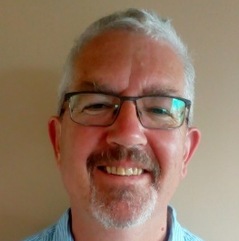
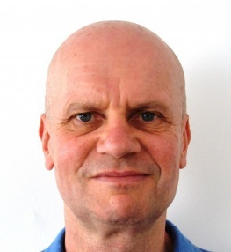
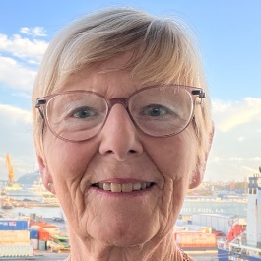
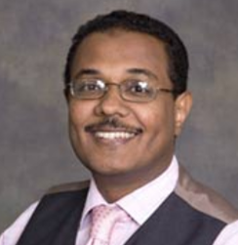
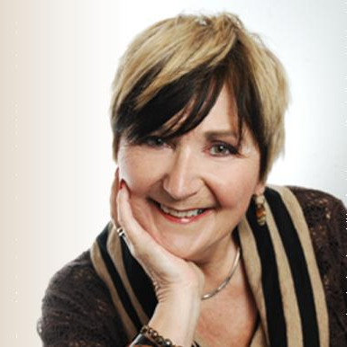
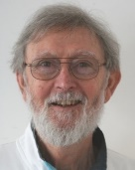
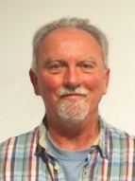
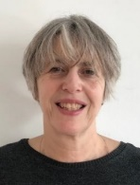

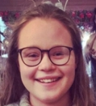
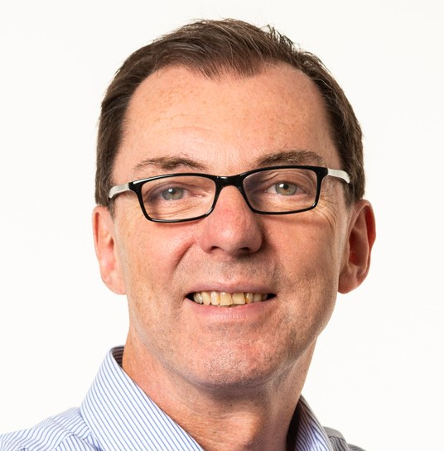
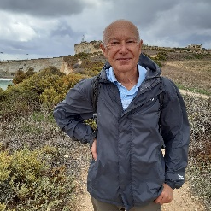
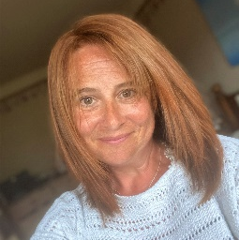
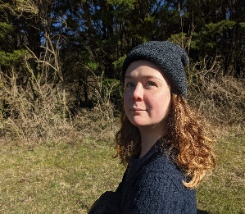
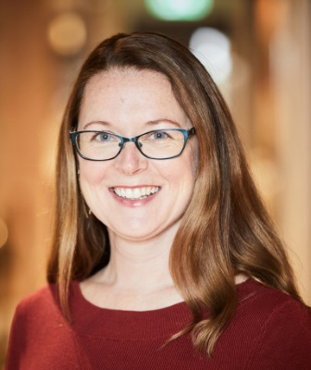
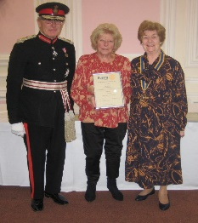
Thank you
Volunteers
Healthwatch Brighton and Hove has been supported by a team of amazing volunteers who have been at the heart of our organisation since 2014. Their efforts have been recognised by two national nominations in the Healthwatch England awards - a brilliant outcome and truly deserved. Thanks to their efforts in the community, we have been able to understand what is working and what needs improving in the NHS and social care. Over the last 10 years, over 150 people have chosen to volunteer for us, which including 25 Board and Governing members.
They have
spoken to thousands of patients
provided answers to over 3000 people who contacted our helpline
answered 1,460 of your COVID related queries via a specialist helpline
helped hundreds of people have their say
“Healthwatch volunteers are constantly challenging us to improve our services and physical environment, to improve the patient experience. They bring clear evidence and a reasoned argument.”
Former Deputy Chief Nurse, Patient Experience, Brighton & Sussex University Hospitals Trust
“
"Healthwatch volunteers have been absolutely amazing - Many thanks for your efforts and contribution to the work on the Vaccination Enquiry Helpline.”
Vaccine Enquiry Manager Feedback B&H Clinical Commissioning Group

Slide 21
Thank you
Chair & Directors
Our board of directors are all volunteers
  Fran McCabe and Geoffrey Bowden
  Chairs
  Neil McIntosh
  Karen Barford
  Dr Khalid Ali
  Sophie Aunounou
  Howard Lewis
  Angelika Wydra
  Alastair Hignell
  Christine D’Cruz
  Chris Morey
  Gillian Connor
  Carol King
  Tony Benton
  Barbara Harris
  Dr Frances Forrester,
  Catherine Swann
  Clare Tikly
  Bob Deschene
  John Davies
  Doris Ndebele
  Mick Lister
  Rachel Travers
  Karin Janzon
  Sophie Reilly
  Directors, Governing Body members and Advisors supporting Healthwatch over the last 10 years
Learn more about our current directors at healthwatchbrightonandhove.co.uk/our-board

Slide 22
Thank you
Staff Team
Our employees over the years
  Nicky Cambridge, David Liley & Alan Boyd
  Chief Executives
  Dr Roland Marsden &
  Dr Lester Coleman
  Head of Research
  Magda Pasiut, Kitty Wallace & Claire Funnell
  Communications Officers
  Rebecca West, Hadi Kebbeh & Clary Collicutt
  Project Support Officers/Assistants
  Steve Turner
  Volunteer Coordinator
  Kerry Dowding, Michelle Kay, Will Anjos, Clary Collicutt & Alan Boyd
  Project Coordinators
  Siobhan Williams
  Personal Assistant
  Claire Jones & Jane Viner Healthwatch Managers
  Elaine Elliott
  Helpline and Information Coordinator
  Heather Pringle
  Operations Coordinator
Learn more about our current staff at healthwatchbrightonandhove.co.uk/our-staff

Slide 23
Thank you
To all of our partners and those who have supported us
Thank you:
To members of the public who shared their views and experience with us.
To all of our amazing staff and volunteers.
To the voluntary organisations that have contributed to our work.
To all NHS staff working across our local trusts, and to all care staff and staff working in allied services.
To all those working in emergency and support services.
To all those working at our local city council and Integrated Care System (and its predecessor the Clinical Commissioning Groups) who have delivered vital services, and listened and responded to our feedback
To all our local and national partners, providers and commissioners working across health and social care.
So thank you to all – in front and behind the scenes – who have supported us and helped to ensure that the patient voice has been listened to and acted on to improve health and social care services for everyone..
Learn more about our current staff at healthwatchbrightonandhove.co.uk/our-staff

Slide 24

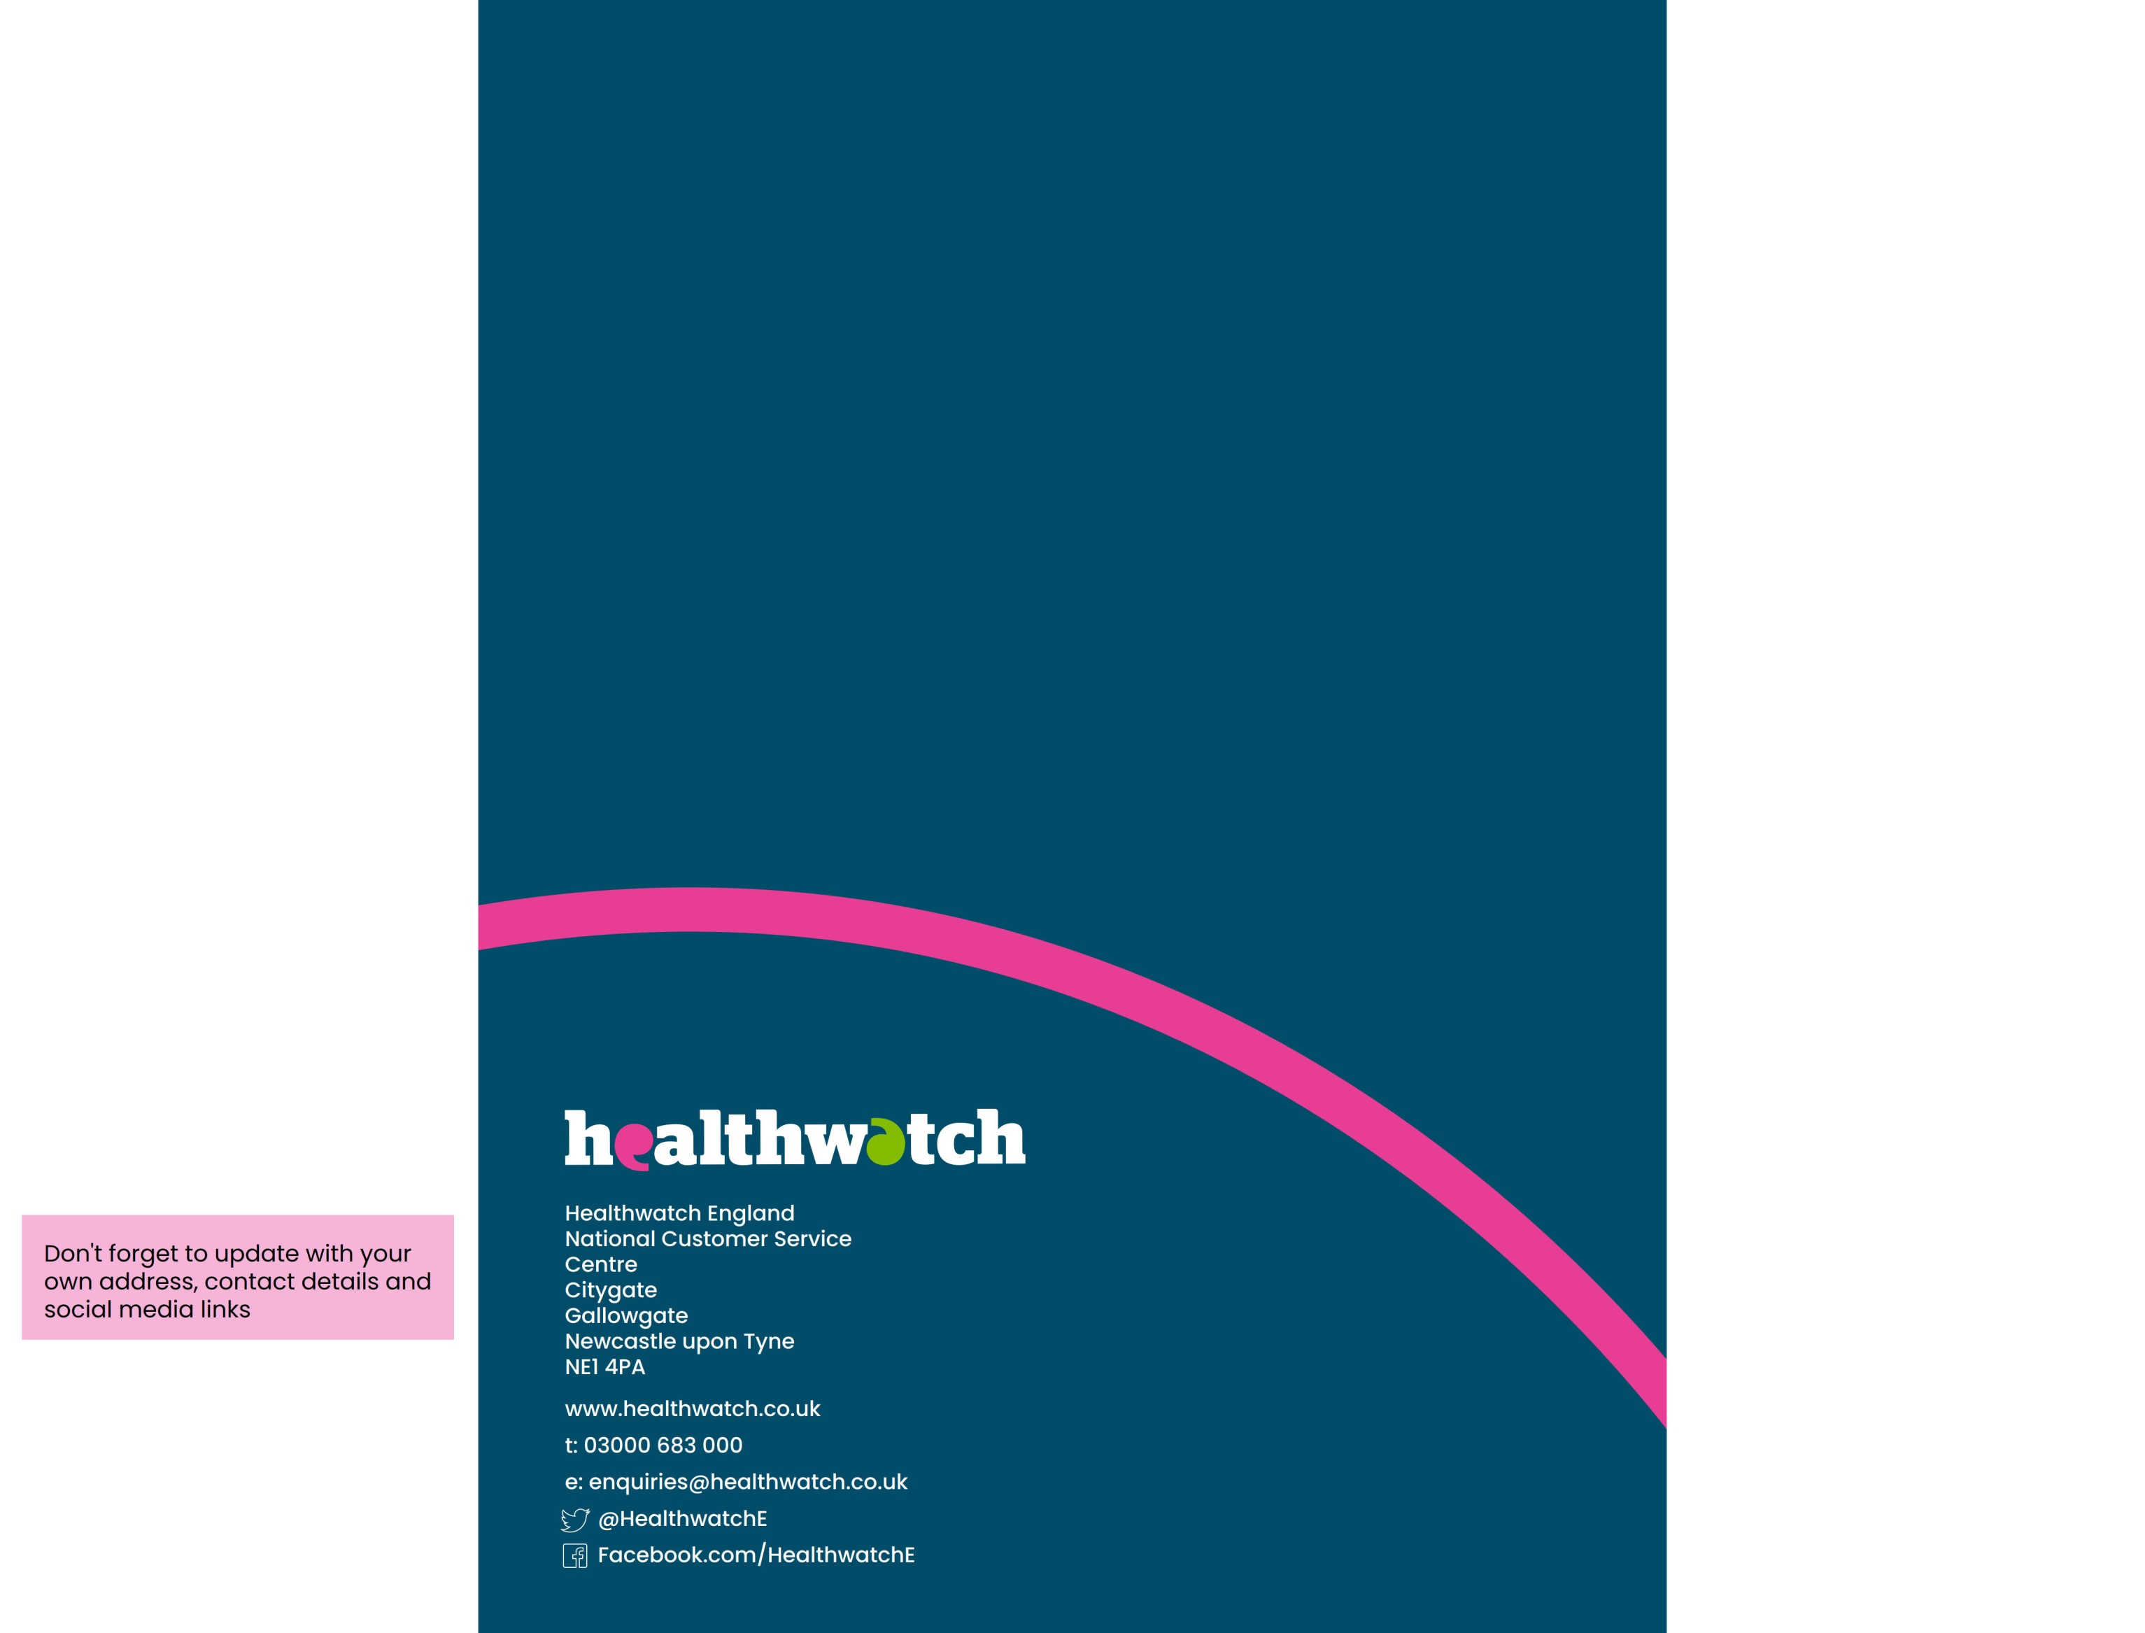

Healthwatch Brighton and Hove
113 Queens Road
Brighton
East Sussex
BN1 3XG
t: 01273 234 040
w: healthwatchbrightonandhove.co.uk
e: office@healthwatchbrightonandhove.co.uk
@HealthwatchBH
@HealthwatchBH
HealthwatchBrightonandHove

