Slide 1
Improving Lives Together
Developing our ambition for a healthier future in Sussex
Sussex Integrated Care Strategy and Shared Delivery Plan

Slide 2
How the
Integrated Health & Care Strategy was developed in partnership with stakeholders including citizens and our workforce

Slide 3
Sussex Strategy Development Principles
The Sussex Health and Care Assembly agreed the following key principles to guide the strategy development process:
Place and population first: We took an approach that considers the principles of place-based working that have been agreed across the system.
Data and evidence: We ensured that our approach was based on evidence, comparative data and responded to population need in line with the above principles.
Co-production: Our communities were central to the creation of the plan. To achieve this, we ensured that every organisation was actively involved and led in the engagement with our communities.
NHS plan: The NHS National Mandate was included within the strategy but did not drive its framing. Health and Wellbeing Strategies underpinned the strategy development process.
Ensuring the most appropriate geography was considered in framing strategic priorities:
  Neighbourhood (i.e. town or local community)
  Place (i.e. local authority footprints of Brighton & Hove, East Sussex or West Sussex)
  Sussex Wide (i.e. overall footprint of NHS Sussex)
The Sussex Health and Care Assembly was responsible for signing off the strategy, with full support and engagement from system partners. This was achieved at the Health and Care Assembly’s Meeting in public 14 December 2022. The Strategy was formally published alongside a week of media campaigns on 30 January 2023.

Slide 4
Simplified governance structure for development and sign off of the Integrated Care Strategy
Input from citizens, workforce and partners
Programme Board
System Leadership Forum
NHS Sussex Governance
Sussex Health and Care Assembly
Local Authority Governance
Council, Cabinet and Committees
Health and Wellbeing Boards
NHS Sussex Board
Integrated Care Strategy
Health Oversight Scrutiny Committees
NHS Sussex
Executive Committee
NHS Delivery Plan
Place Governance
Provider Governance

Slide 5
Our engagement approach – endorsed by the Programme Board made up of Directors of Adult and Children's’ Services and Directors of Public Health
Built on existing insight - not re-engage
Sense checked themes and priorities
Underpinned by collaboration and partnership across the health and care system
Independent and peer review ensured process was systematic & meaningful
Clarity on “what’s next” for ongoing engagement and review after Strategy publication
Strategy underpinned by a comprehensive Equality and Health Inequalities Impact Assessment (EHIA) and Quality Impact Assessment (QIA)
Existing insight
Current priorities
Inequality lens
Insight report - Priorities for our people & communities
July – mid August
Reference group oversight
Sense check: key public stakeholders @ system/place
Sep-Nov
Final strategy
Ongoing insight capture and review
Spring 2023

Slide 6
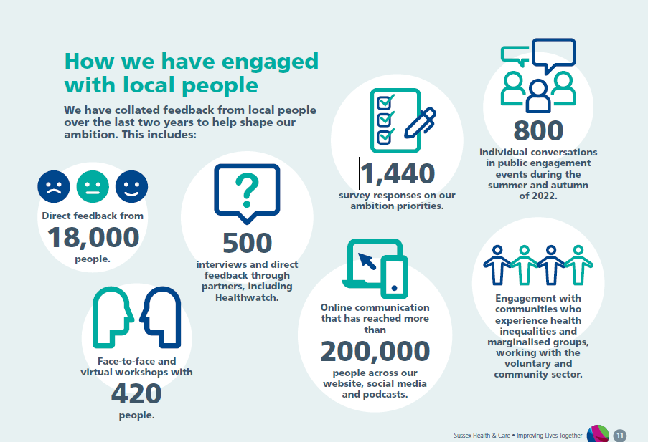

Slide 7

What we are trying to do
We are developing an ambition for health and care that aims to improve the lives of people living across Sussex now and in the future.
It sets out what we want to achieve over the next five years.
Its purpose is to set out the areas of work that we want to achieve across the health and care system that will make the biggest difference to local people.
By working together across all partners, and with local people and communities, we will be able to combine our collective energy, resource and expertise to bring bigger benefits for our population.
It will be built on the Health and Wellbeing Strategies that are already in place across Brighton and Hove, East Sussex and West Sussex, is influenced by supporting information and evidence, has been shaped by feedback and insight from partners and the public engagement, and responds to a number of national strategies, plans and guidelines that need to be met.
The Sussex Health and Care Assembly oversaw its development and will oversee its impact. The Assembly is a new statutory joint committee between the NHS Sussex, Brighton & Hove City Council, East Sussex County Council and West Sussex County Council, and includes membership from a wide range of leaders from the NHS, local authorities, universities, voluntary and community organisations, Healthwatch and other specialist members with expertise in further education, housing and local enterprise.
We are now discussing across organisations, staff, and our communities, what we need to do to make our ambition a reality and put that into a Shared Delivery Plan.

Slide 8


Why we need to change
A lot of work has already taken place across health and care over recent years to improve the support, care and treatment available, and the timeliness of how people access services, and progress has been made that has brought real benefits to local people.
However, we recognise this has still not gone far or fast enough in many areas and a lot of the issues we face can only be resolved with bigger, longer-term and more ambitious change.
There are many issues and challenges that are currently impacting on the health and care of our population, and the services that are available to support them, that means some people are not always getting the experience we all want.
These include:
Greater need for services
We are seeing an increasing need for care and support, which is putting pressure on services and staff, meaning some people are waiting longer than they should for the care, support and treatment. This is due to a number of factors:
  Someone’s life circumstances that are leading to poor health;
  Society and economic environment and conditions our local communities are living within;
  Our growing and ageing population that means more people need more care more often;
  Impact of the pandemic and the current cost of living on people’s health and wellbeing.
Health inequalities
We currently have communities and groups of people who have worse health, outcomes and access to services than other people because of who they are or where they live, particularly for those living in our most deprived areas.

Slide 9




Disjointed care
Local people have told us that services and organisations do not always work in a joined-up way which can cause delays in care and treatment, resulting in poor experiences and outcomes. They have also said that the large number of health and care organisations providing care are variable in quality and can be confusing, making it difficult to know where to go for help when they need it.
Use of digital technology and resources
We need to do more to harness the potential of digital technology to improve access and join-up of services. We also need to get more out of the resources we have available in terms of the buildings we use and the public funding we have to spend.
Development and support for our workforce
There are three key issues that we need to address to better develop and support our workforce:
  The increasing pressure on staff is resulting in more people going off sick and more people leaving health and care professions.
  We are currently unable to recruit enough care professionals to cover vacancies in our services and it takes time to train and develop future staff.
  We are not doing enough to support staff to develop new skills which can be used in the best possible way across different teams and services.
We now have an opportunity to respond and tackle to the issues we face across the Sussex health and care system.

Slide 10




Our ambition for the future
Our ambition is improve the lives of people living across Sussex by supporting them to live healthier for longer and making sure they have access to the best possible services when they need them. We want to:
Help local people start their lives well by:
Improving mother and baby health and wellbeing and supporting parents and carers.
Creating healthy environments for children to grow up in.
Supporting good mental health for all children.
Better supporting the most vulnerable children and young people.
Help local people to live their lives well by:
Supporting people to look after their own health and wellbeing.
Supporting people to live, work and play in places that promote health and wellbeing.
Supporting people who have physical disabilities, learning disabilities and mental health conditions, to have good health and joined up care.
Ensuring more access to services for people who have traditionally been under-served, for example homeless people and other groups.
Help local people to age well by:
Ensuring fewer older people feel lonely or isolated.
Helping older people to stay healthy and live independently for longer.
Reducing the number of older people who suffer falls.
Helping older people receive good quality care at the end of their lives and to die at a place of their choosing.
Help local people get the treatment, care and support they need when they do become ill by:
Tailoring care to support people in their own home, or as close to home as possible.
Supporting the health and wellbeing of informal carers.
Giving them access to the most appropriate and best experts and professionals as early as possible that best suits their needs.
Giving greater joined-up care and support for people with long-term conditions and a number of health issues.
Help our staff get more support, development and work in an by:
Growing our workforce by making it easier for people to
go into care professions.
Providing more and varied training opportunities.
Creating a more inclusive and diverse working
environment.

Slide 11
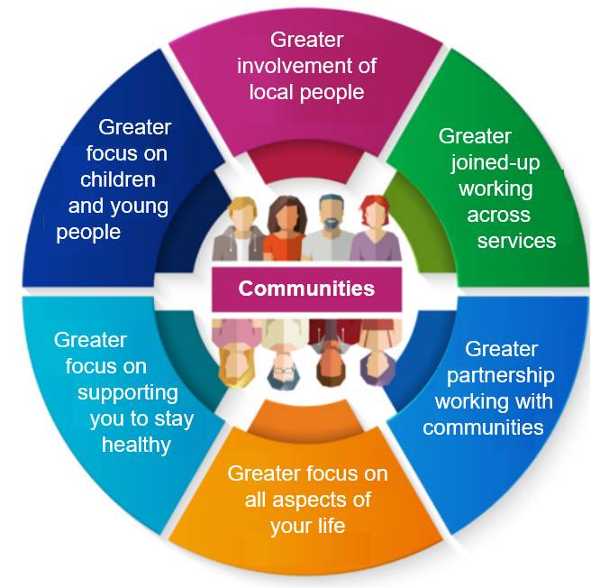
Achieving our ambition
We need to respond to the issues we face, and what local people and staff have said, and make the biggest difference to improve the lives of people living across Sussex.
We will do this with a new Joined-Up Community approach.
This will involve a different way of working to how services are working today. There will be three big differences:
Involvement of local people: Local people, and carers, will be supported to have greater involvement and say in how health and care services work for them.
Joined-up working: Teams of professionals and experts will work closer together across different organisations within local communities to tailor support, care and treatment to what local people need.

Slide 12

Partnership with communities: Health and care will work with communities to shape support and care around what works best for them, building on what already works well and creating new solutions where needed.
We know that every community is different, and local people will have different needs, so there will not be a one-size fits all approach.
As well as changes to how services work, this new way of working will also have three big differences in how we approach health and care for local people:
Bigger focus on all aspects of your life: We will be focusing on all areas of people’s lives that influence their health and wellbeing.
Bigger focus on supporting you to stay healthy: We will focus more of our effort, resource and expertise into helping people you healthy and supporting you to continue to live a fulfilled life if you do become ill or have a health issue.
Bigger focus on our children and young people: We will be focusing on children and young people as we know giving them greater support will help them for the rest of their lives.
Our success factors
For the new way of working to be successful, there are three critical success factors that we need to develop and improve:
Growing and supporting our workforce
Improving the use of digital technology and information
Maximising the benefit of partnership working

Slide 13
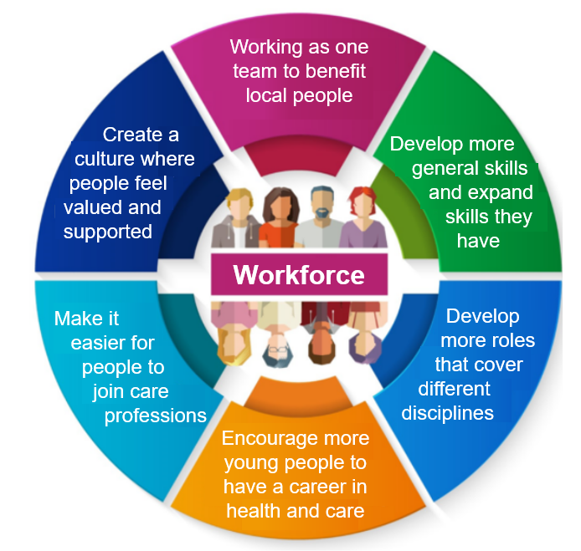
Success factor: Growing and supporting our workforce
To achieve our ambition, we need to grow and develop our workforce and make sure they are more supported to do the best job they can for local people.
There are five key areas we want to achieve:
Joined-up working across the workforce.
We want staff to be able to work more flexibly, to develop more general skills and expand the skills they have.
We want to develop more roles that cover a number of different disciplines and bring greater expertise.
We want to encourage and make it easier for more young people to want and have a career in health and care.
We want to create a culture where people feel valued and supported to develop their skills and expertise at work.

Slide 14
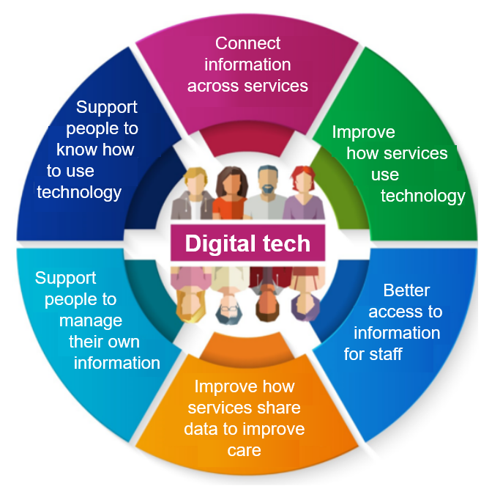
Success factor: Improving the use of digital technology and information
A lot of work has taken place to improve our use of digital technology and information to improve services and help people can access support, care and treatment more easily. However, we are not maximising the potential that it can bring and we need to now focus on how we can better do this to make our ambition a success. There are five key areas we want to achieve:
We want to connect information across our health and care services, so the service and support you receive is as properly joined-up.
We want to improve the way services use technology and how they share data to improve the support, care and treatment they provide.
We want staff to have access to the information they need, wherever they are and whenever they need it, to better support the health and care needs of local people.
We want to support local people to access and manage their own health and care information, care preferences and the way in which they wish to interact with services.
We want to do more to help people use and know how to use digital technology in the way that will best suit them and their needs.

Slide 15

Success factor: Maximising the benefit of partnership working
To achieve our ambition, organisations responsible for the planning, co-ordination, and delivery of health and care need to work closer together and with other organisations that play a part in influencing a person’s health and care.
In addition to working at a local level with communities, we will do this in three ways:
More leadership at “place”: We aim to strengthen how our organisations can work together formally across our populations in Brighton and Hove, East Sussex and West Sussex, focussing on distinct needs and challenges in our local areas. We call this working at “place” and it is where the local NHS, local government and a wide range of local partners come together to shape and transform health and care and the make the most of the collective resources we have available. Our three Health and Care Partnerships will increase ways to offer joined-up care and action to improve health and reduce health inequalities in our local communities.
Working across Sussex: Our new “Health and Care Assembly” will strengthen how key organisations can work together formally on the complex and challenging issues that are shared across Sussex.
This is a new way of working and will mean more
organisations will be able to contribute to improving
health and care, through creating innovative solutions to
help make sure our ambition becomes a reality.
Greater joined-up of the local NHS: The local NHS will be doing more to join-up services across the 1,100 different NHS organisations across Sussex, to improve the experience and outcomes of local people and staff.

Slide 16
Implementing the Sussex Integrated Care Strategy – A Shared Delivery Plan
Full NHS England Guidance: https://www.england.nhs.uk/wp-content/uploads/2022/12/B1940-guidance-on-developing-the-joint-forward-plan-december-2022.pdf

Slide 17
Purpose of the Shared Delivery Plan – (National Guidance)
The Department for Health & Social Care have published guidance for Integrated Care Boards to develop a five-year Shared Delivery Plan providing the integrated care system with a flexible framework which builds on existing system and place strategies and plans, which includes Joint Health and Wellbeing Board Strategies.
The Shared Delivery Plan will describe how NHS Sussex and its partner trusts intend to arrange and/or provide NHS services to meet their population’s physical and mental health needs the delivery of universal NHS commitments, addressing the Health and Care System’s four core purposes and meeting legal requirements.
Principles
Three principles describing the Shared Delivery Plan’s nature and function have been co-developed with ICBs across the country, trusts and national organisations representing local authorities and other system partners. They include;
Principle 1: Fully aligned with the wider system partnership’s ambitions.
Principle 2: Supporting subsidiarity by building on existing local strategies and plans as well as reflecting the universal NHS commitments.
Principle 3: Delivery focused, including specific objectives, trajectories and milestones as appropriate.

Slide 18
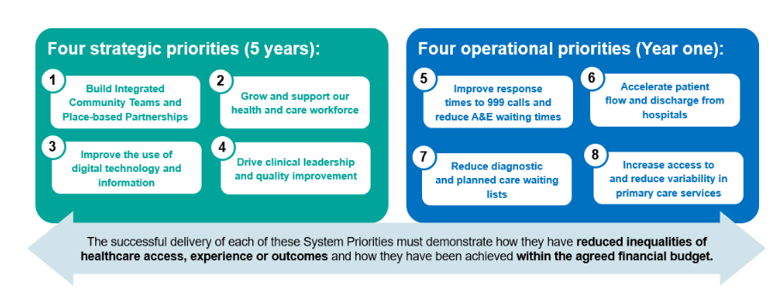
Planning Guidance: our priorities
The areas above will be our key priorities as we go into next year and we will now be discussing across our system partners, Executive and our teams how best we can deliver this as part of the Shared Delivery Plan.

Slide 19
Developing the plan
NHS Sussex is required to provide a first draft of the Shared Delivery Plan by 1st April 2023. However, for this first year, NHS England have stated the final date for publishing and sharing the plan is 30th June 2023, allowing the process of engagement with the Sussex Health and Care Assembly, Health and Wellbeing Boards and NHS England to continue after 31st March but ensuring a final iteration is signed off by 30th June.
The Shared Delivery Plan will be delivered as a single plan that incorporates the Operating Plan requirements for 2023/24 and the delivery plan for the five-year Sussex Health and Care Improving Lives Together Strategy set within a framework document that will bring together a consistent narrative around strategic change and operational delivery, pulling in content from the approved Strategy and respective Place plans.
The March 2023 submission will consist of high-level information on the Operational Plan and the detail of Year One response to the Integrated Care Strategy, plus a vision and roadmap for years two to five of the Strategy (noting that an initial draft of the Operating Plan must be submitted to NHSE on 23 February 2023).
The June 2023 submission will set out the delivery objectives for years two to five of the Strategy in more detail.
Chief Executive Officer, Senior Responsible Officers and respective Integrated Care Board Chief Officer leads have been aligned for each of the priority areas of the Shared Delivery Plan and an engagement, planning and approval approach with Local Authority leads is also being confirmed.

Slide 20
Shared Delivery Plan Framework
The below framework will form the basis of the shared delivery plan. It incorporates all of the mandated content set out in the national guidance and attempts to mirror the approach of the Integrated Care Strategy
Summary of framework
1. Delivering Improving Lives Together
Introductory statement from partners and Exec summary – consistent with strategy
2. Our population and how we work
• Overview of Sussex population and how system works – aligned with strategy supporting documents.
3. Our ambition for a healthier future
Sets out ambition – consistent with strategy
Life course, service improvement and workforce
Sets out other strategic imperatives and aims:
Improving health and health outcomes of our most disadvantaged communities and individuals (Health inequalities)
Working better and smarter, and getting the most value out of funding we have (finance)
Doing more to support our communities to develop socially and economically (social and economic development)
Protecting those who are victims of abuse (Safeguarding)
4. Making our ambition a reality: Our year one high impact actions
Year one change for long-term improvement (Descriptor, key actions for each and by when)
Developing Integrated Community Teams
Improving the use of digital technology and information
Growing and developing our workforce
Maximising the power of partnerships a place and delivery of our health and wellbeing strategies
Year one actions for immediate improvements (Descriptor, key actions for each and by when)
Increasing access to and reduce variability in primary care.
Improving response times to 999 calls and reduce A&E waiting times.
Reducing diagnostic and planned care waiting lists.
Accelerating patient flow through, and discharge from, hospitals.
5. Developing our Shared Delivery Plan
• Approach and principles
• Evidence, research and change methodology
• Governance and leadership
• Engagement and partnerships
• Performance, scrutiny and assurance
• How we own, share and manage risk across the system

Slide 21
Developing the plan – engagement
Our proposed approach:
National guidance stipulates the local approach to be determined by NHS Sussex and partner trusts but should build on and reflect existing joint strategic needs assessments, joint health and wellbeing strategies and NHS delivery plans as well as local patient and public engagement exercises already undertaken.
Given the extensive and successful engagement approach to co-developing the Sussex Integrated Care Strategy, feedback and insight already gained from citizens and our workforce will be used to inform development of the Shared Delivery Plan.
In addition, a robust governance structure overseeing the development of the plan, will ensure that this insight is directly applied to the areas identified by the national guidance.
In line with the national guidance, key stakeholders and groups, such as Healthwatch, Health and Wellbeing Boards and the Sussex Health and Care Assembly will be actively engaged. The respective Health Overview and Scrutiny Committees will be invited to scrutinise the final plans, in the usual way.
Close engagement with partners will be essential to the development of Shared Delivery Plan. This includes working with:
the Sussex Health and Care Assembly (ensuring this also provides the perspective of social care providers)
primary care providers
local authorities and each relevant Health and Wellbeing Board
other ICBs in respect of providers whose operating boundary spans multiple ICSs
NHS collaboratives, networks and alliances
the voluntary, community and social enterprise sector
people and communities that will be affected by specific parts of the proposed plan, or who are likely to have a significant interest in any of its objectives, in accordance with the requirement to consult.

Slide 22
Role of the Health & Wellbeing Board
In preparing or revising the Shared Delivery Plan, NHS Sussex and partner trusts are subject to a general legal duty to involve each Health and Wellbeing Board.
NHS Sussex and partner trusts must send a draft of the Shared Delivery Plan to each Health and Wellbeing Board when initially developing it or undertaking significant revisions or updates. They must consult those Health and Wellbeing Boards on whether the draft takes proper account of each joint local health and wellbeing strategy that relates to any part of the period to which the shared delivery plan relates – describing how NHS Sussex proposes to implement the joint health and wellbeing strategies.
A Health and Wellbeing Board must respond with its opinion and may also send that opinion to NHS England, telling NHS Sussex and its partner trusts it has done so (unless it informed them in advance that it was planning to do so).
Role of NHS England
NHS England will review and comment on the draft shared delivery plan, and recommend this is done in parallel with the review by Health and Wellbeing Boards. This is not a formal assurance process but an opportunity to support NHS Sussex and their partner trusts to develop their plans.
Role of Health Overview and Scrutiny Committees
NHS Sussex and their partner trusts should expect to be held to account for its delivery – including by their population, patients and their carers or representatives and in particular through the Sussex Health and Care Assembly, Healthwatch and the local authorities’ health overview and scrutiny committees.
Sign off process for the Shared Delivery Plan
NHS Sussex and their partner trusts should agree processes for finalising and signing off the Shared Delivery Plan. The final version must be published.
Annual updates & revision of the plan
NHS Sussex and partner trusts should review their shared delivery plan before the start of each financial year, by updating or confirming that it is being maintained for the next financial year. It may also revise the plan in-year if considered necessary.
The annual refresh of shared delivery plans allows them to be iterated and provides the opportunity for further engagement and collaboration, as well as the opportunity to continue to reflect the most appropriate delivery mechanisms and partners’ actions.
If NHS Sussex and its partner trusts update the shared delivery plan, in a way they consider to be significant, the same requirements regarding engagement and consultation will apply.

Slide 23








Timeline
Sussex
Health and Care Assembly
Council Meetings
Sussex ICB Meeting
Workshop
SLF
Deadline
4 January 2023 NHS Sussex Board Meeting
Receiving the ICP Strategy
9 February 2023
SLF
7 March 2023
East Sussex Health and Wellbeing Board
7 March 2023
Brighton and Hove Health and Wellbeing Board
9 March 2023
SLF
29 March 2023
NHS Sussex Board Meeting
27 April 2023
West Sussex Health and Wellbeing Board
11 May 2023
SLF
June 2023 PROPOSED NHS Sussex Board Meeting
Sign off of final SDP
8 June 2023
SLF
30 June 2023
Final sign off of SDP
27 February
2023
Strategy delivery workshop
14 June 2023
West Sussex HOSC
29 June 2023
East Sussex HOSC
1 March 2023 NHS Sussex Board Meeting
31 March 2023
First draft of SDP
03 May 2023 NHS Sussex Board Meeting
Update on development of SDP
17 May 2023
Sussex Health and Care Assembly
07 June 2023 ICB Seminar
12 January 2023
SLF
13 April 2023
SLF
Phase 1: Initial Drafting
Phase 2: Final Editing and Sign off
PROPOSED: Weekly updates through the informal executive weekly meetings
HOSC Meetings available in March and April as a potential opportunity for visibility scrutiny (Esx 02/03, WSx 08/03, B&H 12/04)

Slide 24
Engagement in the development of the Shared Delivery Plan
Requirements:
Close engagement with partners will be essential to the development of Shared Delivery Plan. This includes working with:
the voluntary, community and social enterprise sector
people and communities that will be affected by specific parts of the proposed plan, or who are likely to have a significant interest in any of its objectives, in accordance with the requirement to consult.
The Delivery plan should describe how:
The public and communities were engaged in the development of the plan
The ICB and partners will work together to build effective partnerships with people and communities, particularly those facing the greatest health inequalities
Activity at place and neighbourhood level informs decisions by the system
How public involvement duties are met and assured

Slide 25
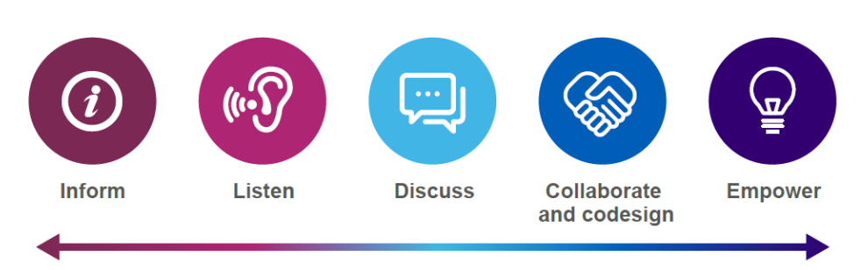
What is our public involvement approach?
Build on existing insight
Proportionate
Intelligent and targeted
Collaborative
Continuous

Slide 26
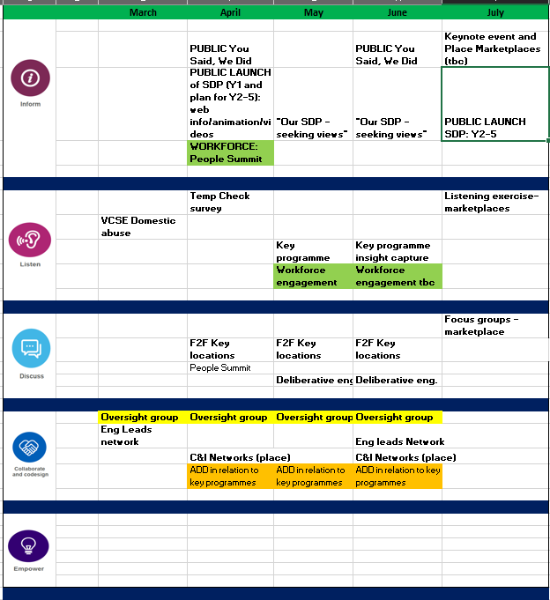
What is our public involvement approach?

Slide 27
Role of the Oversight Group
Advise on the public involvement approach
Support on shaping insight capture and advise on collaborative approaches
Review communications products and advise on format and targeting
Review and advise on programme based insight capture, including fit with existing insight
Support as required final narrative in the SDP
Advise on next steps
To Agree:
Frequency, duration, membership
Scope in terms of workforce engagement

