Slide 1
Data Update
8th September 2020

Slide 2
ECRs
26 ECRs (cop 8th Sept) , significantly above trajectory.

Slide 3
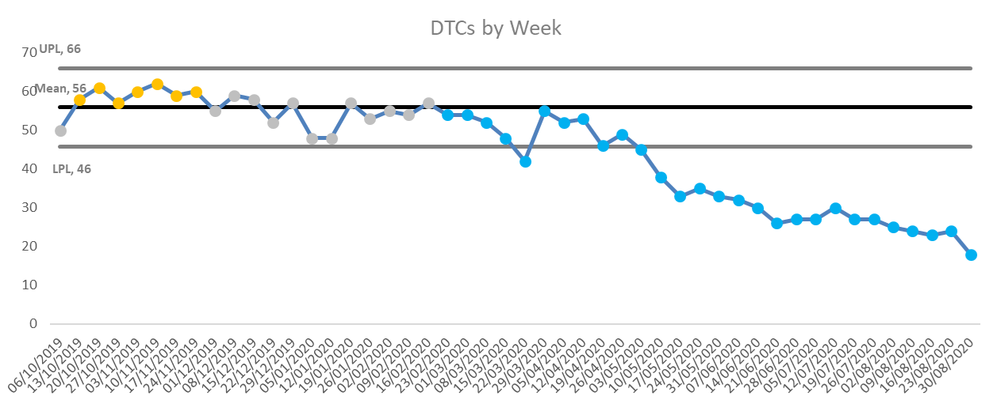
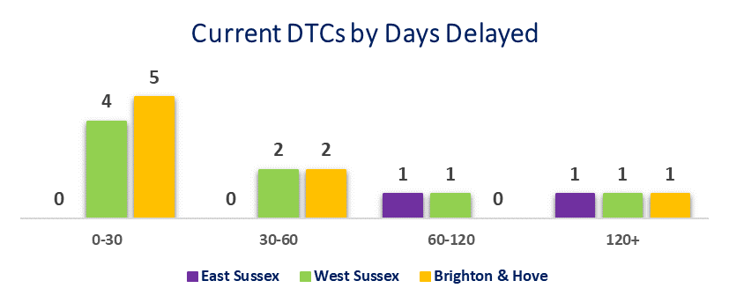
DTOCs
18 DTOCs as at Sunday 30th August (acute, dementia, integrated, older people & rehab)
3 delayed for over 120 days

Slide 4
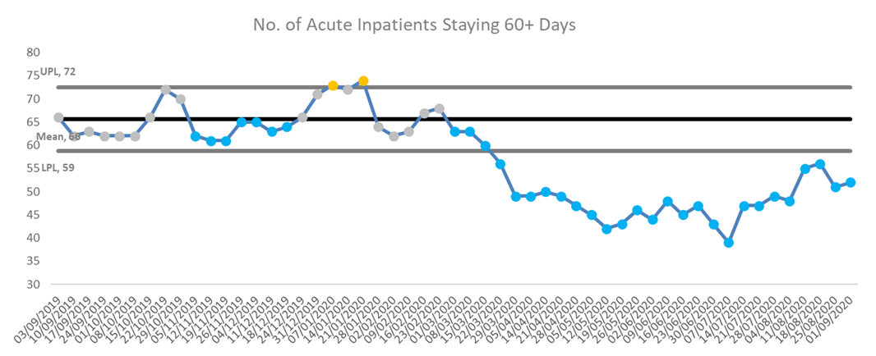
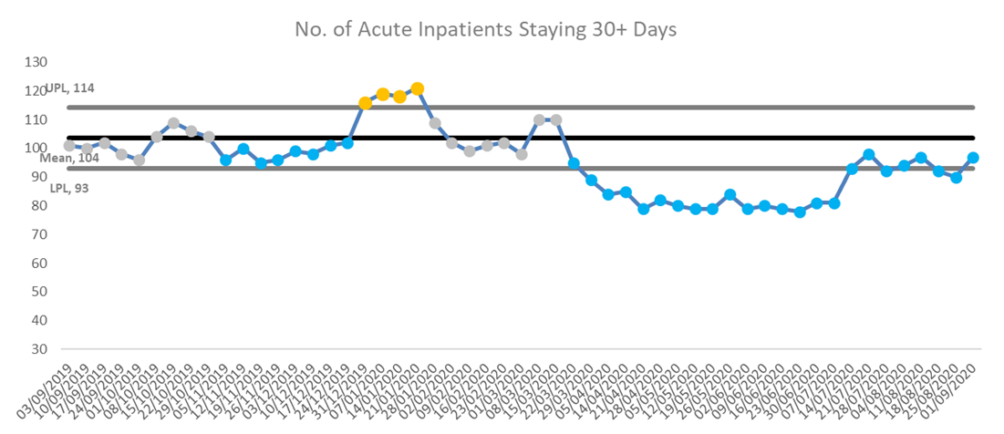
Long Length of Stay
The number of acute inpatients staying over 60 days has remained significantly below normal levels since March and is currently 52.
The number of acute inpatients staying over 30 days, while remaining significantly below average, is now back to close to normal levels. Currently 97.
*Control limits and mean, used to define normal variation, have been set on baseline period of Sept-19 to Feb-20 (pre-COVID19)

Slide 5
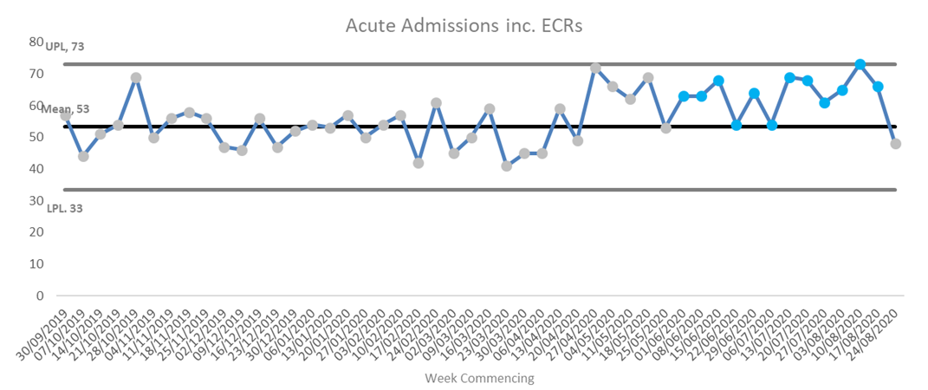
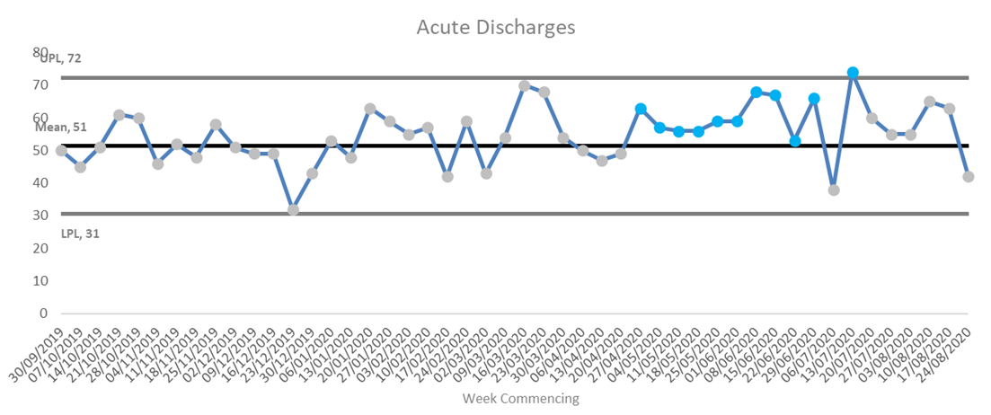
Admission and Discharge Trends
The last week (ending Sunday 30th August) saw a lower numbers of admissions and discharges than recent weeks. This this may be due, in part, to delays in recording admissions and discharges over the BH weekend.
Prior to this, there has been a period of 12 weeks, since early June, with significantly higher than usual acute admissions.
This period also saw the majority of weeks with a significantly higher than usual number of acute discharges, suggesting that ‘flow’ through acute beds was higher than normal.
This is backed up by lower than average length of stay for acute patients discharged during May, June and July.
*Control limits and mean, used to define normal variation, have been set on baseline period of Sept-19 to Feb-20 (pre-COVID19)

Slide 6
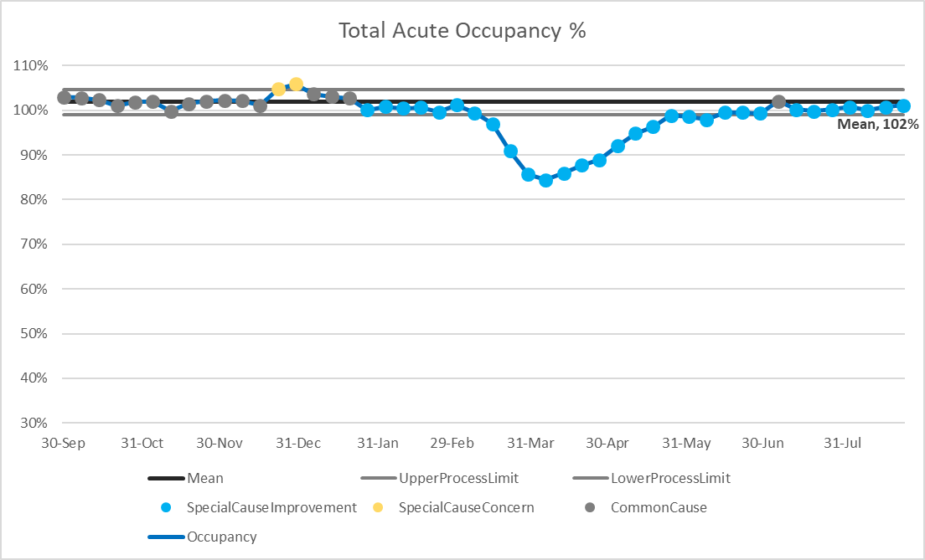
Occupancy - Acute
At Trust level, occupancy % has been back to within the normal range since early July.
However, it remains slightly below the pre-COVID average on working age wards and there is also some local variation.
The only exception is rehab, where capacity is reduced due to cohorting for COVID.
*Total acute includes working ages, older adult functional and PICU.

Slide 7
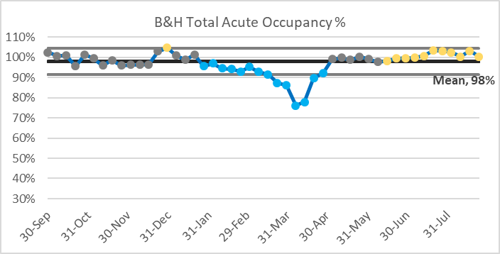
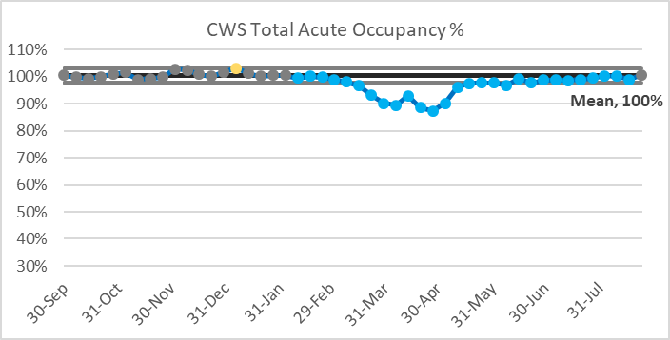
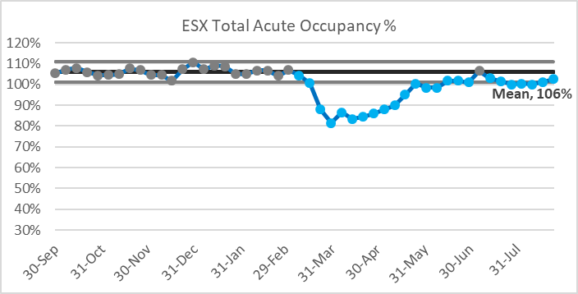
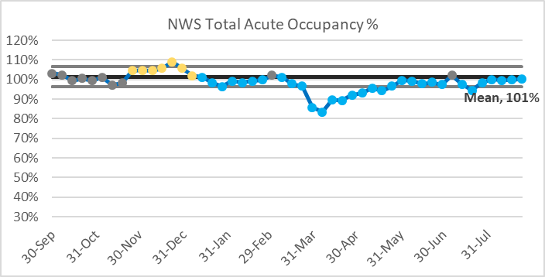
Occupancy – Acute(2)
While at Trust level total acute occupancy is slightly below the pre-COVID, this is not the case across all CDS with Brighton in particular being significantly above pre-COVID levels.
It is also interesting to note the variation in the pre-COVID average occupancy levels between CDS.

Slide 8
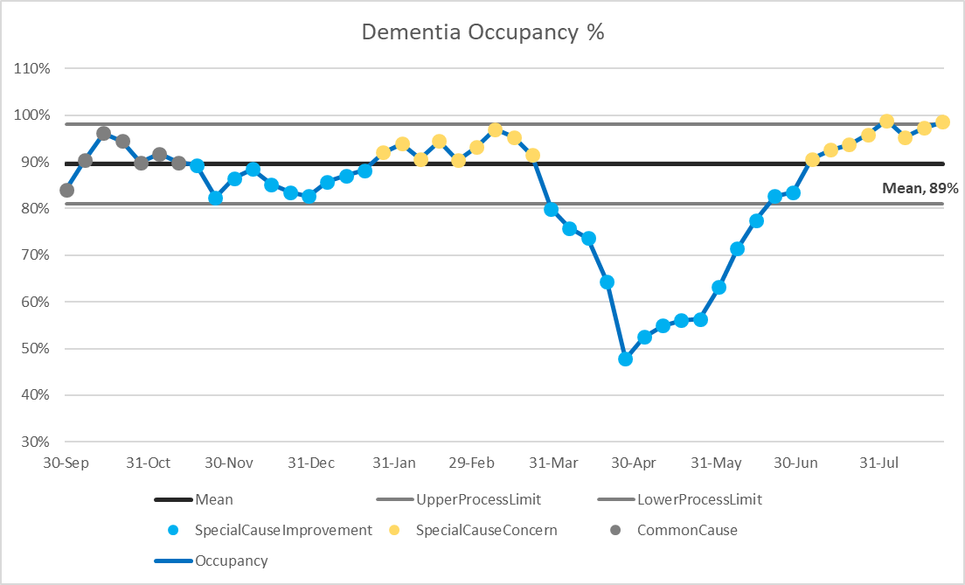
Occupancy – Dementia
At Trust level, dementia occupancy % is significantly above average and are on an increasing trend.
*Total acute includes working ages, older adult functional and PICU.

Slide 9
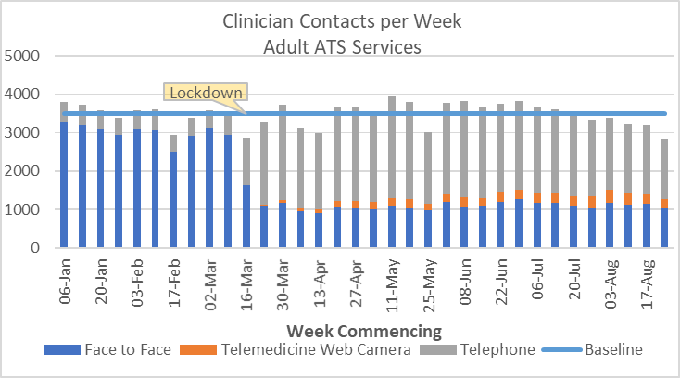
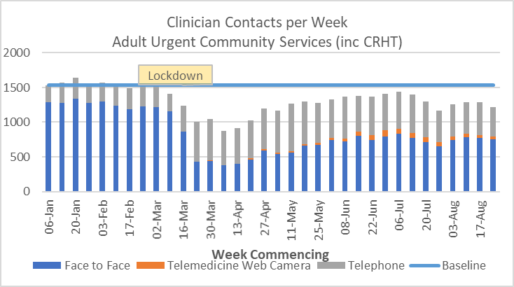
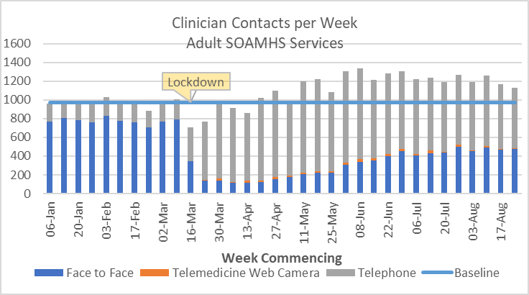
Contacts to 30/08/2020
Contacts for adult ATS remain slightly below pre-COVID levels and with a high proportion of telephone and web cam contacts.
Contacts for adult urgent community services remain well below pre-COVID levels.
SOAMHS contacts have been above pre-COVID levels for a number of months, with a significant proportion of telephone contacts. However, these figures may be affected by the service reconfiguration in West Sussex.

Slide 10
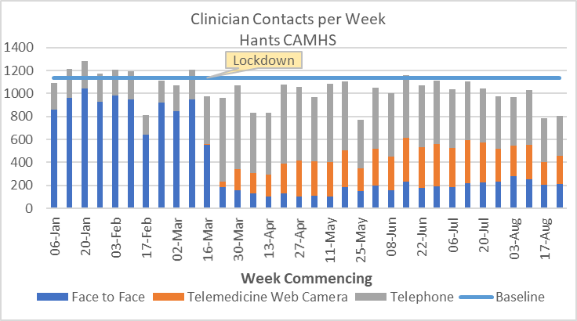
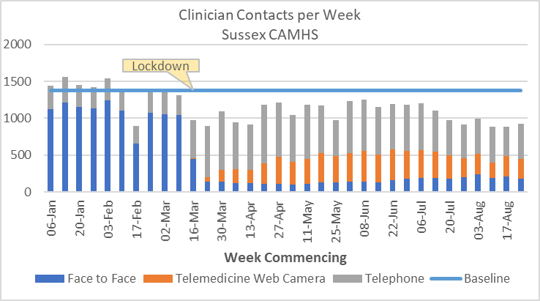
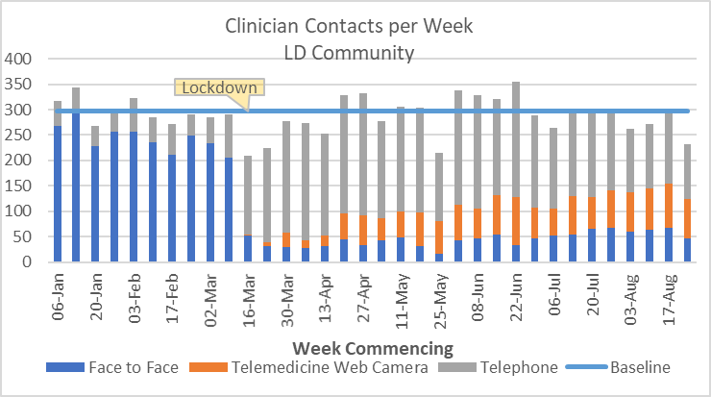
Contacts to 30/08/2020 (2)
Contacts for both Hampshire and Sussex CAMHS remain well below pre-COVID levels.
Both continue to deliver a significant proportion of contacts via telephone and webcam.
LD contacts are close to pre-COVID levels but with a high proportion of telephone and webcam contacts.

Slide 11
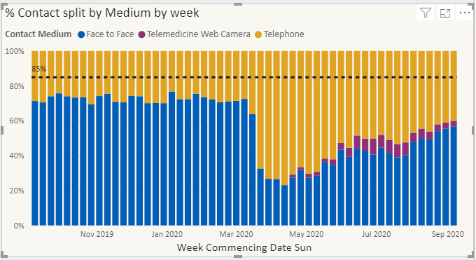
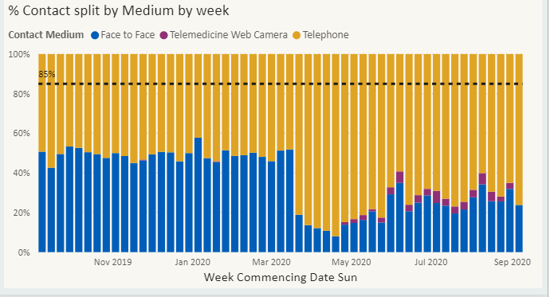
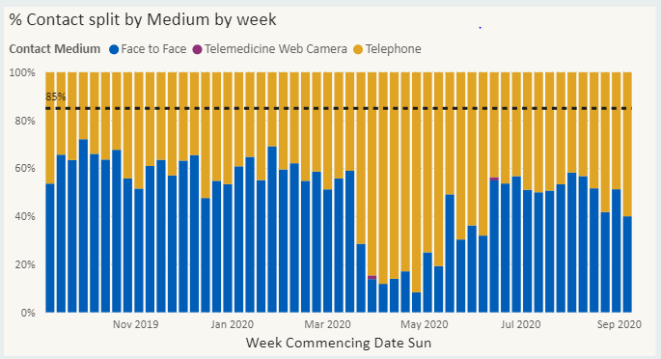
CRHT – Contacts by Medium
Eastbourne CRHT
Hastings CRHT

Slide 12
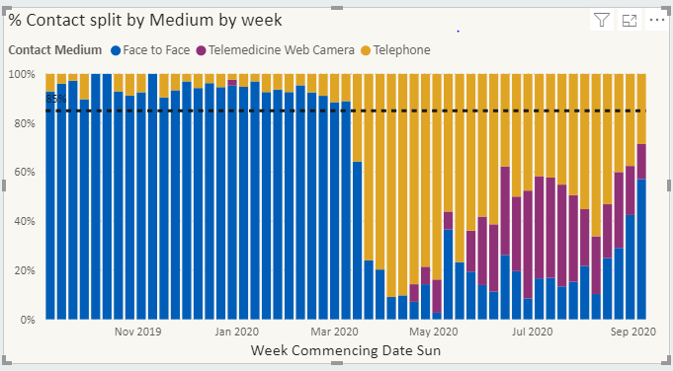
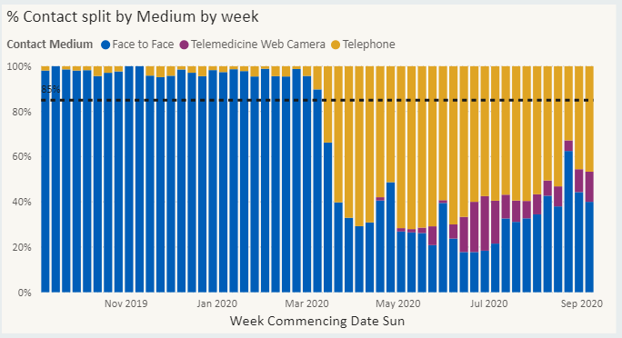
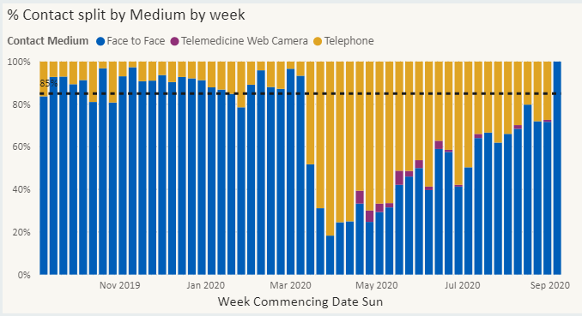
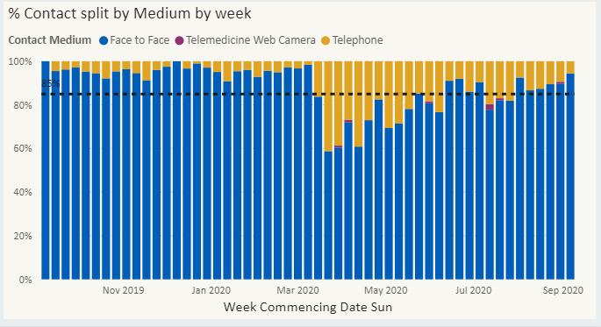
CRHT – Contacts by Medium
Chichester CRHT
Worthing CRHT
Northern West Sussex CRHT
Brighton CRHT

Slide 13
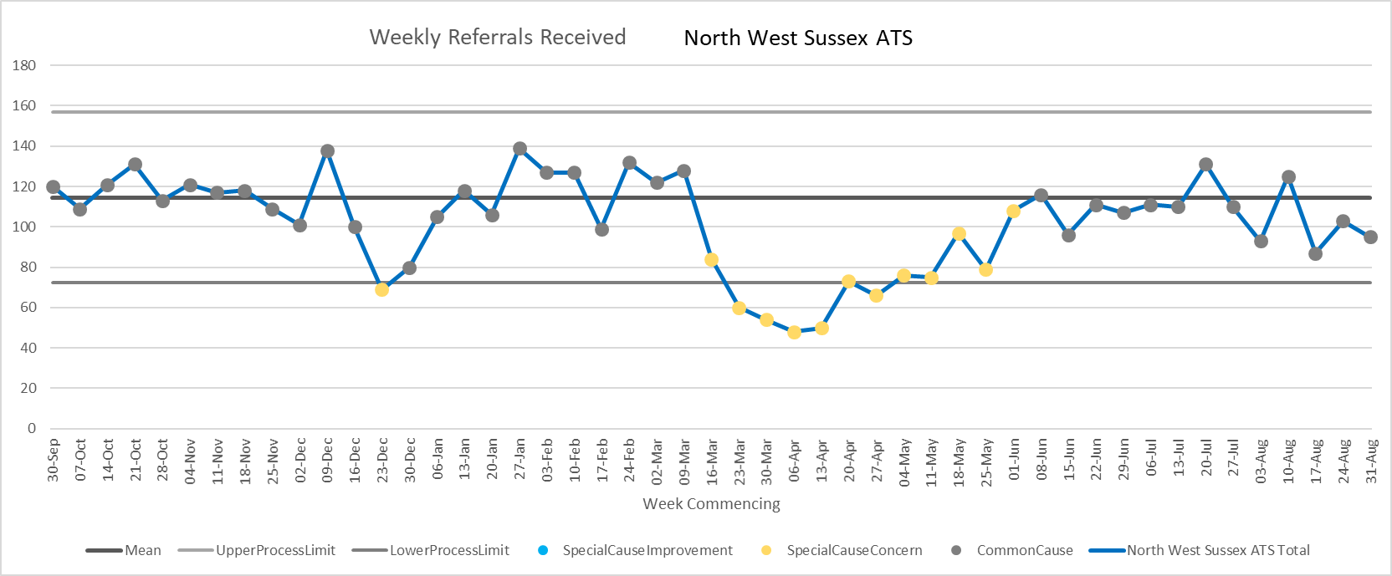
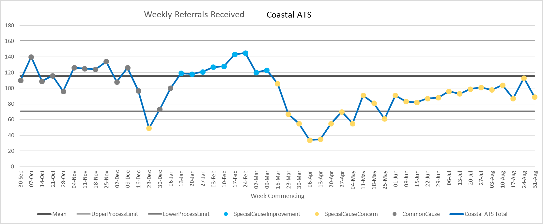
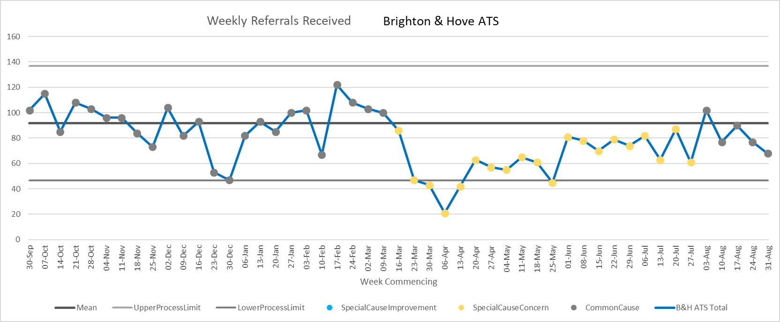
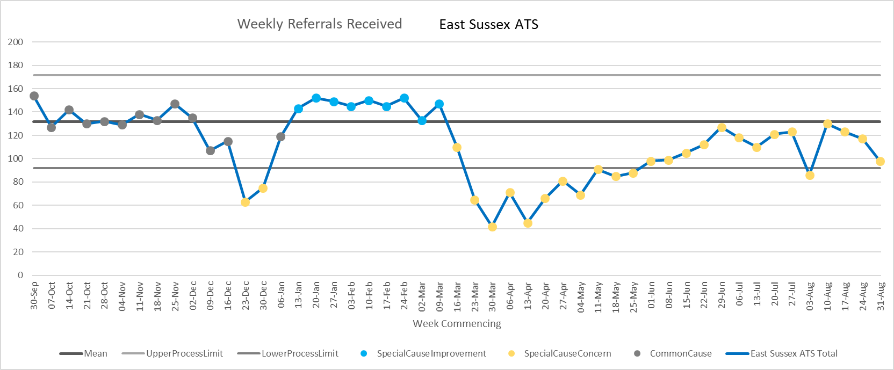
Weekly Referrals – Adult ATS

Slide 14
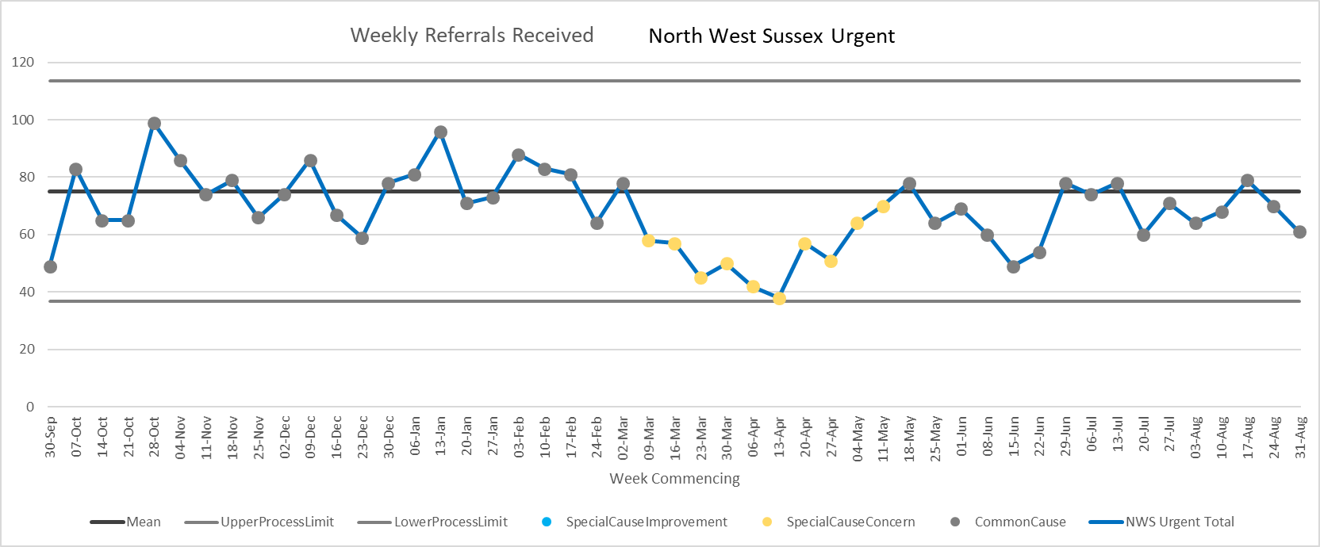
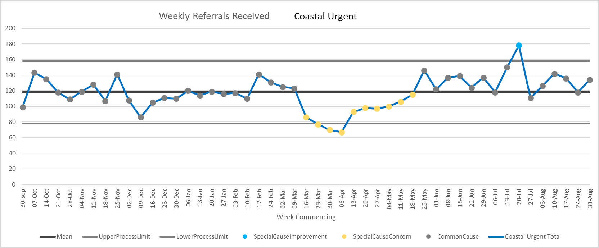
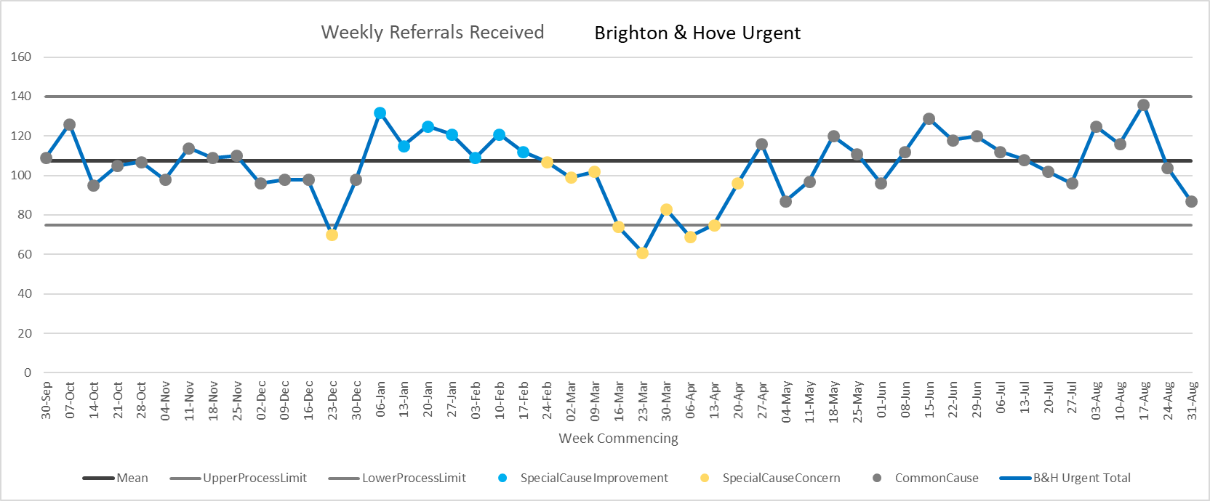
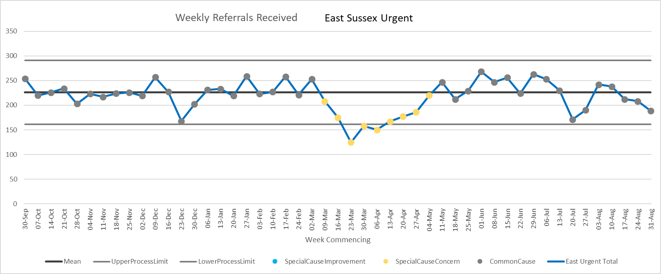
Weekly Referrals – Urgent Community

Slide 15
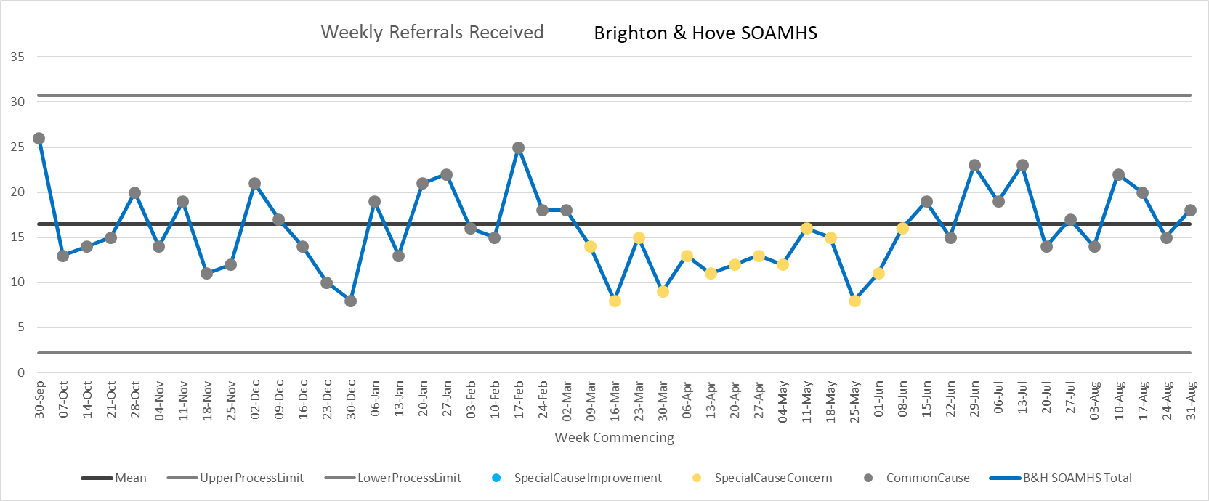
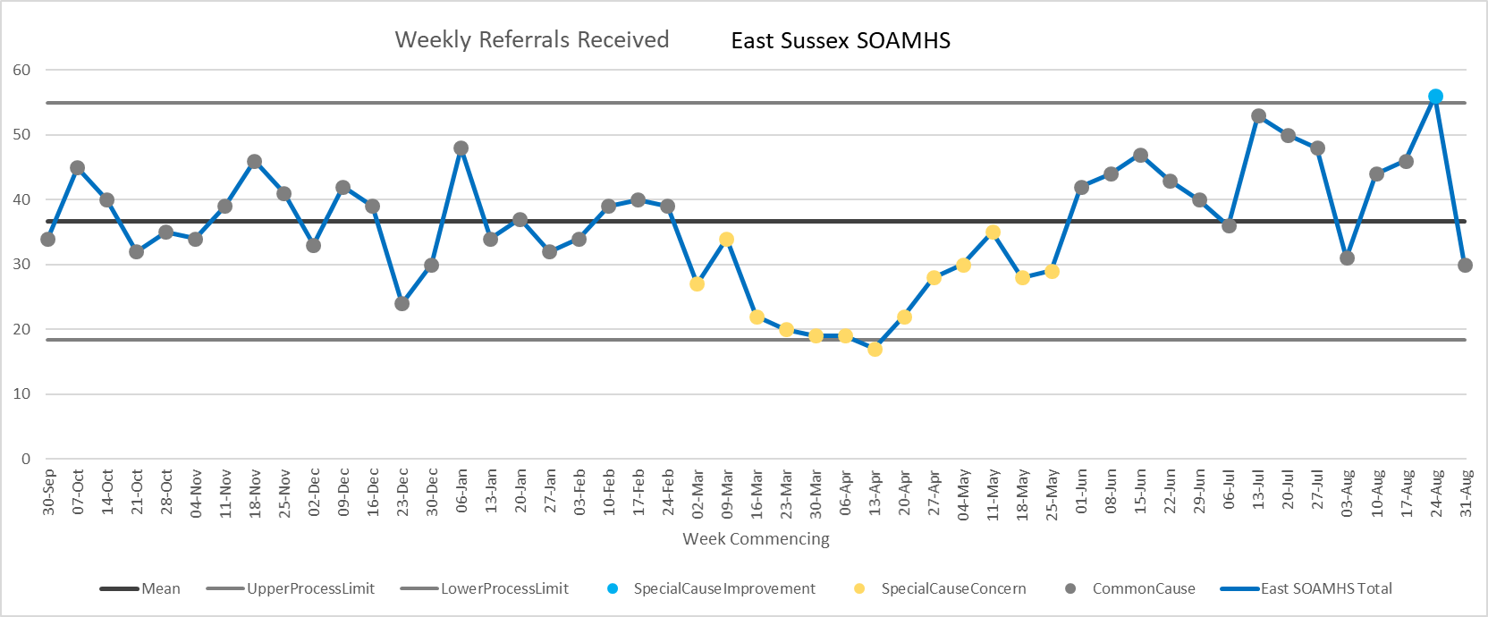
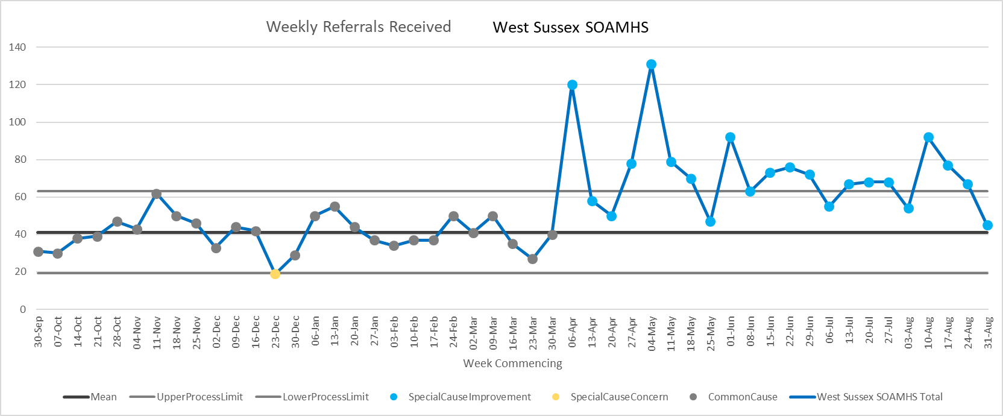
Weekly Referrals – SOAMHS

Slide 16
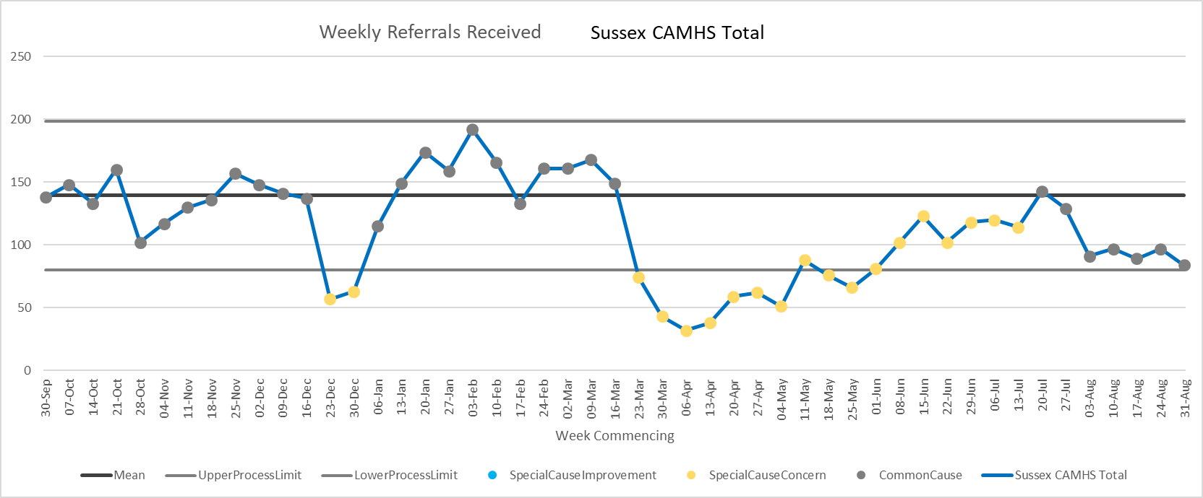
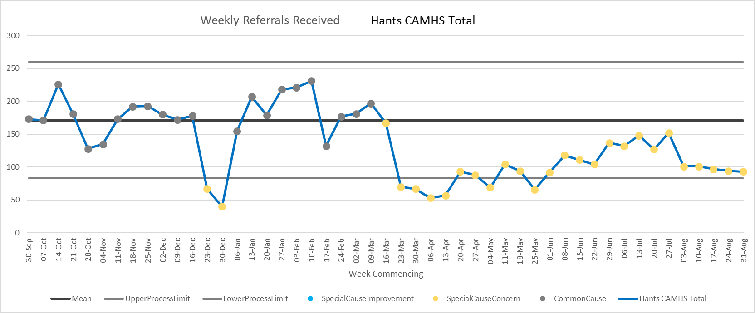
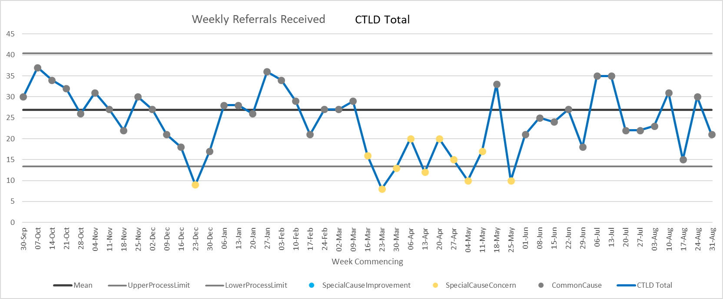
Weekly Referrals – CAMHS & LD

