Slide 1
Sector Connector
Simone Button, Programme Director, Foundations for our Future
March 2022

Slide 2
The Review
Pan Sussex review commissioned by:
- CCG
- Sussex Partnership NHS Foundation Trust
- 3 Local Authorities
Whole system review of Emotional Wellbeing and Mental Health access and support for children and young people.
Children and young people, families, and stakeholders actively engaged in review.
Report published March 2020.
2 year implementation plan, with 20 recommendations arranged around a series of themes.

Slide 3
Themes and Actions
Radical re-design of the service model with more effective pathways; improved access and better outcomes
Focused investment on priorities and outcomes
Improved effective partnership working
Listening, co-production and co-design with young people
Co-ordinated strategic commissioning and capable leadership to drive improvement
Strategic outcomes framework linked to return on investment
Simple provision map to ease navigation for families to get help easily and quickly
Level of investment to reflect and meet local need
Accurate available data from whole system
Workforce challenges to be addressed

Slide 4
Key
20 Recommendations for implementation
Status
End date
Foundations for our Future (FFOF) led work
1 – Establish an Oversight Board responsible for the implementation of the recommendations 23.11.20
Complete
Work fed through and linked to CYP MH Programme
2 – A concordat agreement developed and agreed 04.05.21
3 – NHS and Local Authority to jointly create a Programme Director 30.06.21
On Track
4 – Establish a co-ordinated commissioning structure 31.03.22
5 – Develop Sussex-wide commissioning and contracting of specialist mental health services 31.03.22
6 – Develop one strategic plan for children and young peoples emotional health, wellbeing & MH in Sussex 31.03.22
7 – Develop a strengths based & resilience led Sussex-wide outcomes framework 31.03.22
8 – Investment planning and levelling of current and future spend 31.03.22
9 – Develop clear and targeted investment plan for gaps in service/provision for each area 01.02.22
10 – Review current landscape of service provision and identify any gaps in the pathway 31.03.22
11 – Develop and implement a Single Point of Access (SPOA) model across Sussex 31.03.23
12 – Organisations within SPFT review and re-describe thresholds and criteria for access to their services 31.03.22
13 – The acceleration and expansion of the piloting of Mental Health Support Teams in schools 31.03.23
14 – A demand and capacity and productivity review of all commissioned services.
(NOTE: Relates to Emotional Wellbeing. Demand & Capacity for Specialist CAMHS also being undertaken 31.03.22
as part of CYP Mental Health programme.
15 – Organisations in Sussex should ensure service levels and capacity are matched to local need 31.03.22
16 – Communication of a clear description of the pathway model and about how and where to refer 31.03.22
17 – To improve accessibility and flexibility of service offer 31.03.23
18 – A workforce review of specialist and targeted services 31.03.22
19 – Children and Young People to have a greater say in how resources are spent 31.03.23
20 – Establish a children & young people’s panel to ensure children & young people involvement in FFOF implementation 31.03.23
Notes:
Can we add to this to indicate what is being delivered through CYP MH programme?

Slide 5
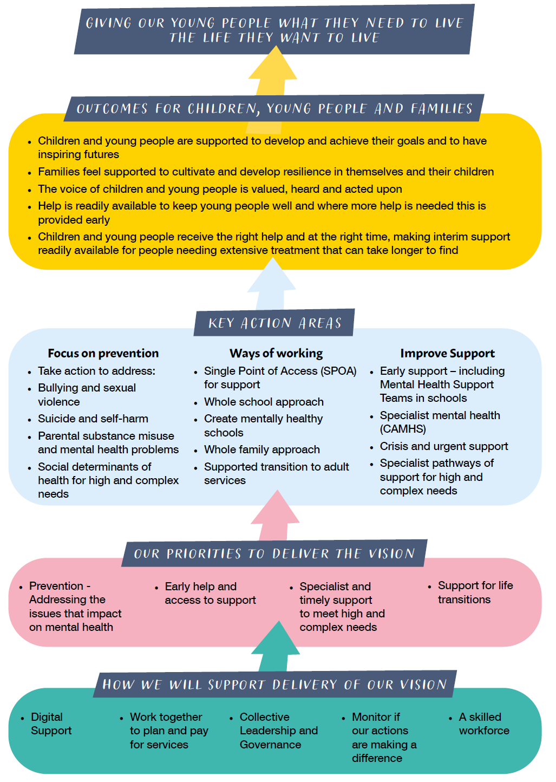

Slide 6
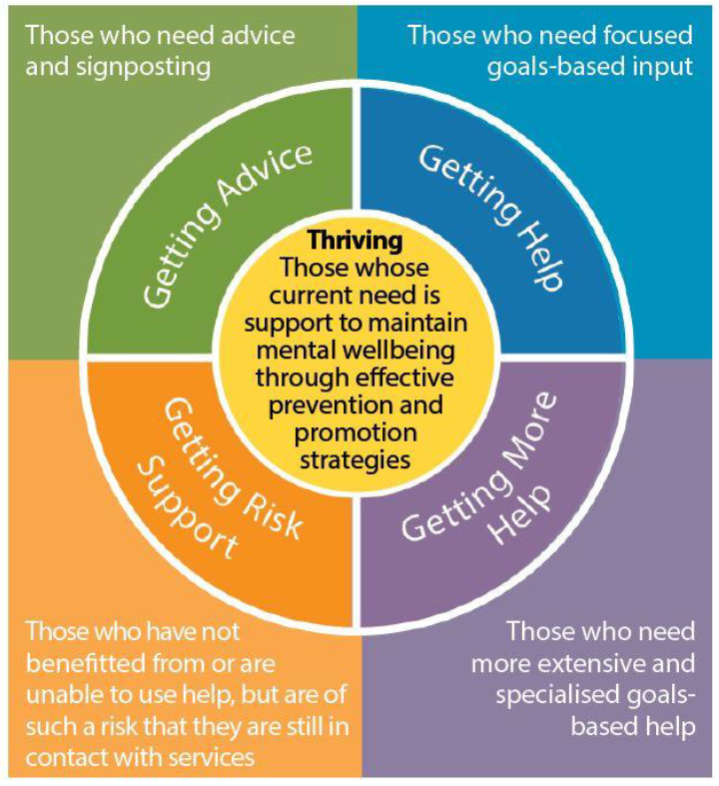
Implementing the THRIVE Framework
THRIVE:
a model of National good practice.
an integrated, person-centred and needs-led approach to delivering MH services for children, young people and their families.
provides a set of principles for creating coherent and resource-efficient communities of mental health support.
aims to talk about mental health and wellbeing help and support in a common language that everyone understands.
How we’re using THRIVE:
To support the development of a whole system strategy to improve the emotional wellbeing and mental health of children and young people in Sussex.
We have:
collated feedback from young people about the use of THRIVE, the language used, and what it could look like across Sussex.
collated feedback from families/ carers about the use of THRIVE and what this means to them.
worked with national experts in whole system approaches to hold a series of workshops with stakeholders across Sussex on THRIVE implementation, to form a comprehensive picture of:
the current system of services for children and young people’s mental health
understand the challenges that the system faces
assess the particular needs of the local population
think about the values, behaviours and any necessary culture change

